Slide 1
Lecture 1 The research process
Lecture 1
Kevin Ralston, University of Edinburgh

Slide 2
Welcome
Welcome! Great to see you all.
Wow! So many chose data analysis.
I’m a sociologist I’m not use to people choosing data analysis!

Slide 3
Class times and locations
Data analysis will be on Tuesday mornings (9:30-12:15) and on Friday afternoons (13:45-16:30).
The location will be room g.06 at Thomson's Land in Moray House. The first class will start promptly at 9:30 on Tuesday 6th June.
Toilets are down the hall
Fire alarms – test due on Tuesdays I think

Slide 4
Today
We will learn about the research process.
Processes for producing robust, replicable research
We will learn about research proposals
Criteria for writing proposals.
Issues around generating research proposals.
The first piece of coursework
Practical:
How to get data into and out of SPSS
Syntax file
Online practical’s for getting data into and out of SPSS

Slide 5
Approach
I do some teaching and introduce concepts and resources
Mainly its over to you
Evidence shows lecturing is not as effective as actively engaging students
Therefore a lot of the course is about practical engagement
Often with online resources

Slide 6
Resources
A text book
https://openstax.org/details/introductory-statistics
A SPSS programming book
https://developer.ibm.com/predictiveanalytics/wp-content/uploads/sites/48/2015/04/Programming-and-Data-Management-for-IBM-SPSS-Statistics-23.pdf
A site where you can download our data
http://www.restore.ac.uk/Longitudinal/workshop_materials.html

Slide 7
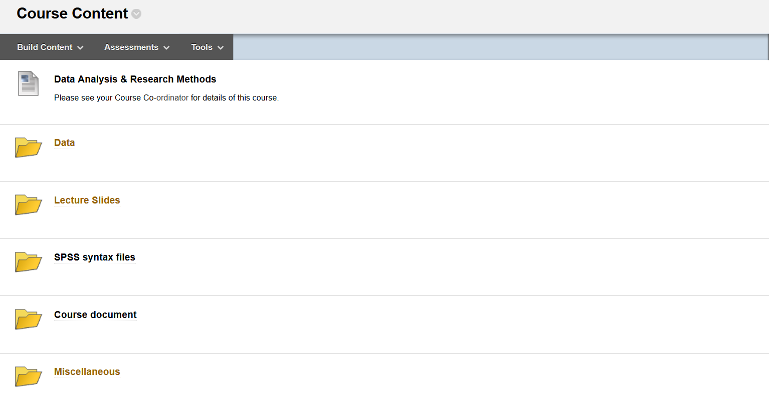
Files on LEARN

Slide 8
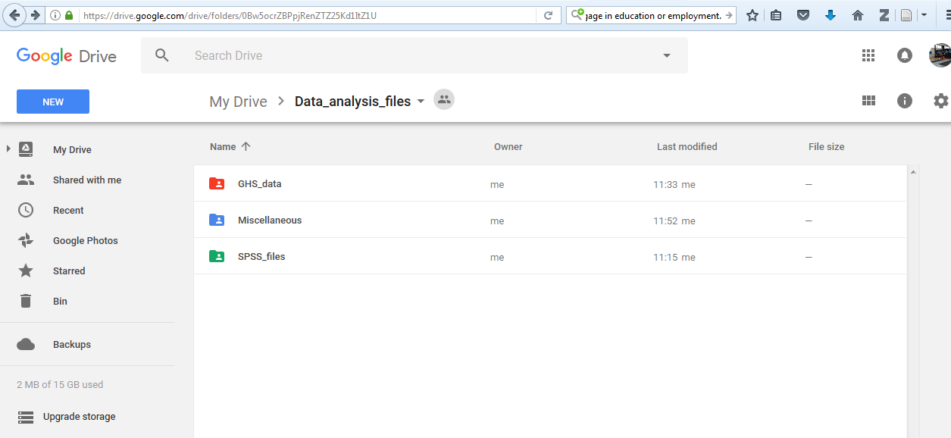
The Google Drive site for this course
https://drive.google.com/open?id=0Bw5ocrZBPpjRenZTZ25Kd1ItZ1U

Slide 9
Software
It is unrealistic to undertake anything more than extremely basic
analyses of survey data without using data analysis software
There are many: R, Python (Pandas), SAS, Stata, MLwiN
https://en.wikipedia.org/wiki/List_of_statistical_packages
The labs in this course are in SPSS, feel free to use another package at any point of the course if you like

Slide 10
SPSS
Lets look at SPSS
The second piece of coursework requires a piece of analysis
We’ll talk a bit more about this work on Friday
You can use SPSS in Edinburgh University computer labs
You can find it on computers in the Library labs
You can download it to a personal computer/laptop
http://www.ed.ac.uk/information-services/computing/desktop-personal/software/main-software-deals/spss/getting-spss/spss-non-managed

Slide 11
Working with data
The UK Data Service
Supplies datasets in SPSS format (also Stata and SAS)
https://www.ukdataservice.ac.uk/

Slide 12
Data is almost never in a form that renders them immediately ready for comprehensive analyses:
Different available data files
Different measures (of the similar things, education, social class)
Need to undertake data enabling
Recode variables
Coding missing
Longitudinal data is more complex than cross sectional

Slide 13
Document
Longs law:
Its easier to document today than tomorrow
No one likes to document
No one regrets documenting
Make notes, they record everything you do, and you use them to write your report

Slide 14
File directories
Adopt a file structure
Software Packages require it to be specified where the
Storing in the ‘cloud’ might be nice, but it may be impossible for analysis software to access the data here.

Slide 15
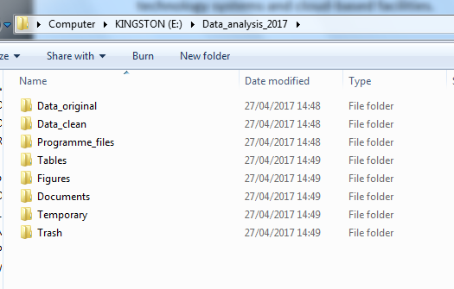
Example file structure
define !path1 () ‘E:\Data_analysis\Data_clean\’ !enddefine.
(the location of your working directory - where you will save newly created data files and output) .

Slide 16
File naming protocol
File Name = title_date_depositor's initials_version_type
E.g
ghs95_20170427_kr_v1.sav
kr: Kevin Ralston
v1: version 1
.sav: SPSS data format
.sps: SPSS syntax format
Meaningful
Name
Date in searchable
format

Slide 17
Syntax files
Don’t use interactive GUI’s for analysis
Clear and consistently well organised and annotated syntax files are central to accurate, efficient, reproducible, and transparent survey data analysis
Syntax programming files in SPSS have the .sps extention

Slide 18
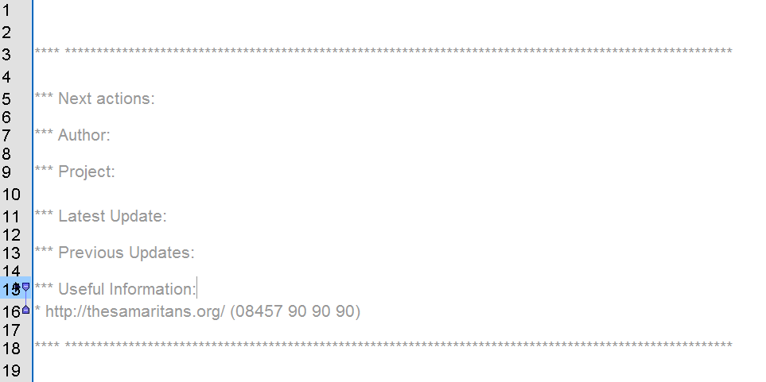

Slide 19
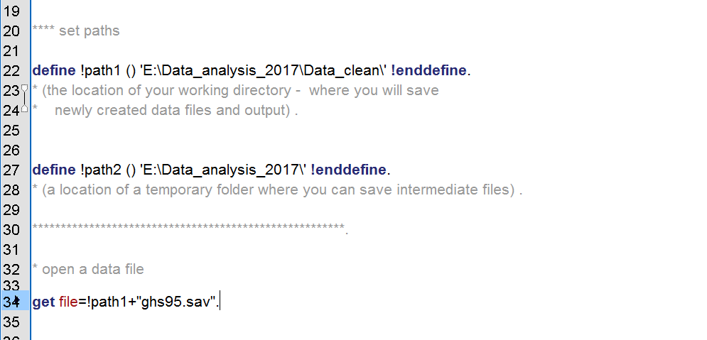
Specify Global Macros

Slide 20
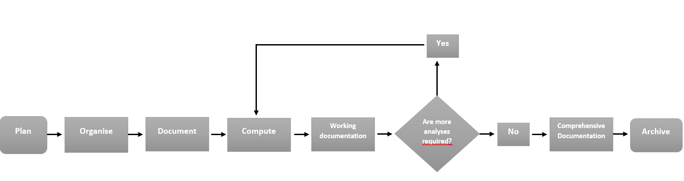
Statistical analyses: the research workflow
Lamert and Gayle (2017) The Workflow: A Practical Guide to Producing Accurate, Efficient, Transparent and Reproducible Social Survey Data Analysis, NCRM Working Paper

Slide 21
Statistical Analyses: the research workflow
Plan
Organise
Document
Compute
Working documentation
Are more analyses required?
Yes
No
Comprehensive Documentation
Archive

Slide 22
Research - what you want to look at is up to you
Is there any subject you think you’d like to research?
Have a think, discuss with a neighbour or in a small group.
It might be difficult to get data
You’re welcome to use the GHS teaching dataset

Slide 23
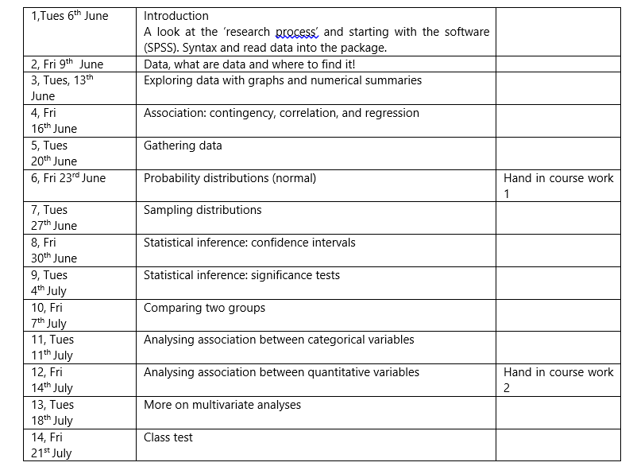

Slide 24
Course work 1
Due: Fri 23rd June
Around 1000 words (excluding 100 word abstract)
A research proposal:
Title
Abstract
Research Context
Research Questions
Research Methods
Significance of Research
Bibliography

Slide 25
Course work 1
A research proposal is a concise and coherent summary of your proposed research. It sets out the central issues or questions that you intend to address. It outlines the general area of study within which your research falls, referring to the current state of knowledge and any recent debates on the topic.

Slide 26
Course work 1
There is loads of advice available online… and in the course document.
E.g.
Birmingham University
Great section on formulating a research question
http://www.socscidiss.bham.ac.uk/

Slide 27
Lab and practical
The first lab is simply a very short piece of syntax specifying paths and reading a SPSS dataset into the package
Then there are two online practical’s available
One on entering data into SPSS by hand
The other on reading data into SPSS from different formats
You may not get through both, but they are resources that you can refer to when and if you need to input data in these ways

Slide 28
Exercise in creating data, lets do this!:
http://libguides.library.kent.edu/SPSS/CreateData
http://www.stattutorials.com/SPSS/TUTORIAL-SPSS-Create-a-data-set.htm

Slide 29
Lecture 2 Fantastic Data:
And where to find them

Slide 30
Recap from Monday:
Well done… !!!!!!!!!!!
Paths are one of the trickiest parts of programming
You all did really well…
I’m sorry that its such a fiddly and buggy process
from a programming point of view, it should be easier now we have gone through
I’m sorry it is just me supporting…

Slide 31
What we did
Well you opened SPSS (for the first time)
You specified a path and told SPSS to find the data there and read it in
You told SPSS to save it out
We also had a lecture where we talked about the research process
You ‘discovered’ the course document
We talked about the first piece of coursework.

Slide 32
The first piece of coursework
Produce a research proposal <1000 wds
This is homework and currently due Fri 23rd June
We can make this Tuesday 27th?
A research proposal:
Title
Abstract
Research Context
Research Questions
Research Methods
Significance of Research
Bibliography

Slide 33
Research Proposal
A research proposal is a concise and coherent summary of your proposed research. It sets out the central issues or questions that you intend to address. It outlines the general area of study within which your research falls, referring to the current state of knowledge and any recent debates on the topic.
A research proposal:
Title
Abstract
Research Context
Research Questions
Research Methods
Significance of Research
Bibliography

Slide 34
Data….

Slide 35
What are Data?
What are data?
Data are plain facts, usually raw numbers. Think of a spreadsheet full of numbers with no meaningful description. In order for these numbers to become information, they must be interpreted to have meaning.
Who creates data?
Data can come from a government census or organization surveys or research studies.
Why the ARE in "data are?"
Datum (singular form) - a piece of information
Data (plural form) - multiple pieces of information

Slide 36
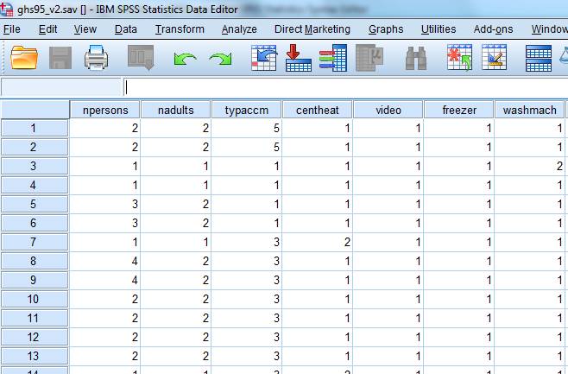
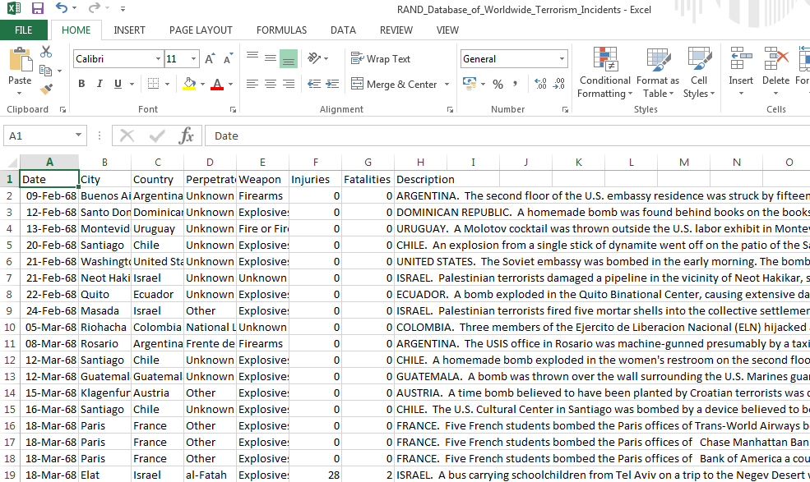
Recognizing data
How will I know it is data?
What forms does it take?
Data might be audio files, video, geospatial or digital content.
A data file might look like this:
A typical flat variable by case matrix

Slide 37
Variable by case matrix
Variables
Cases

Slide 38
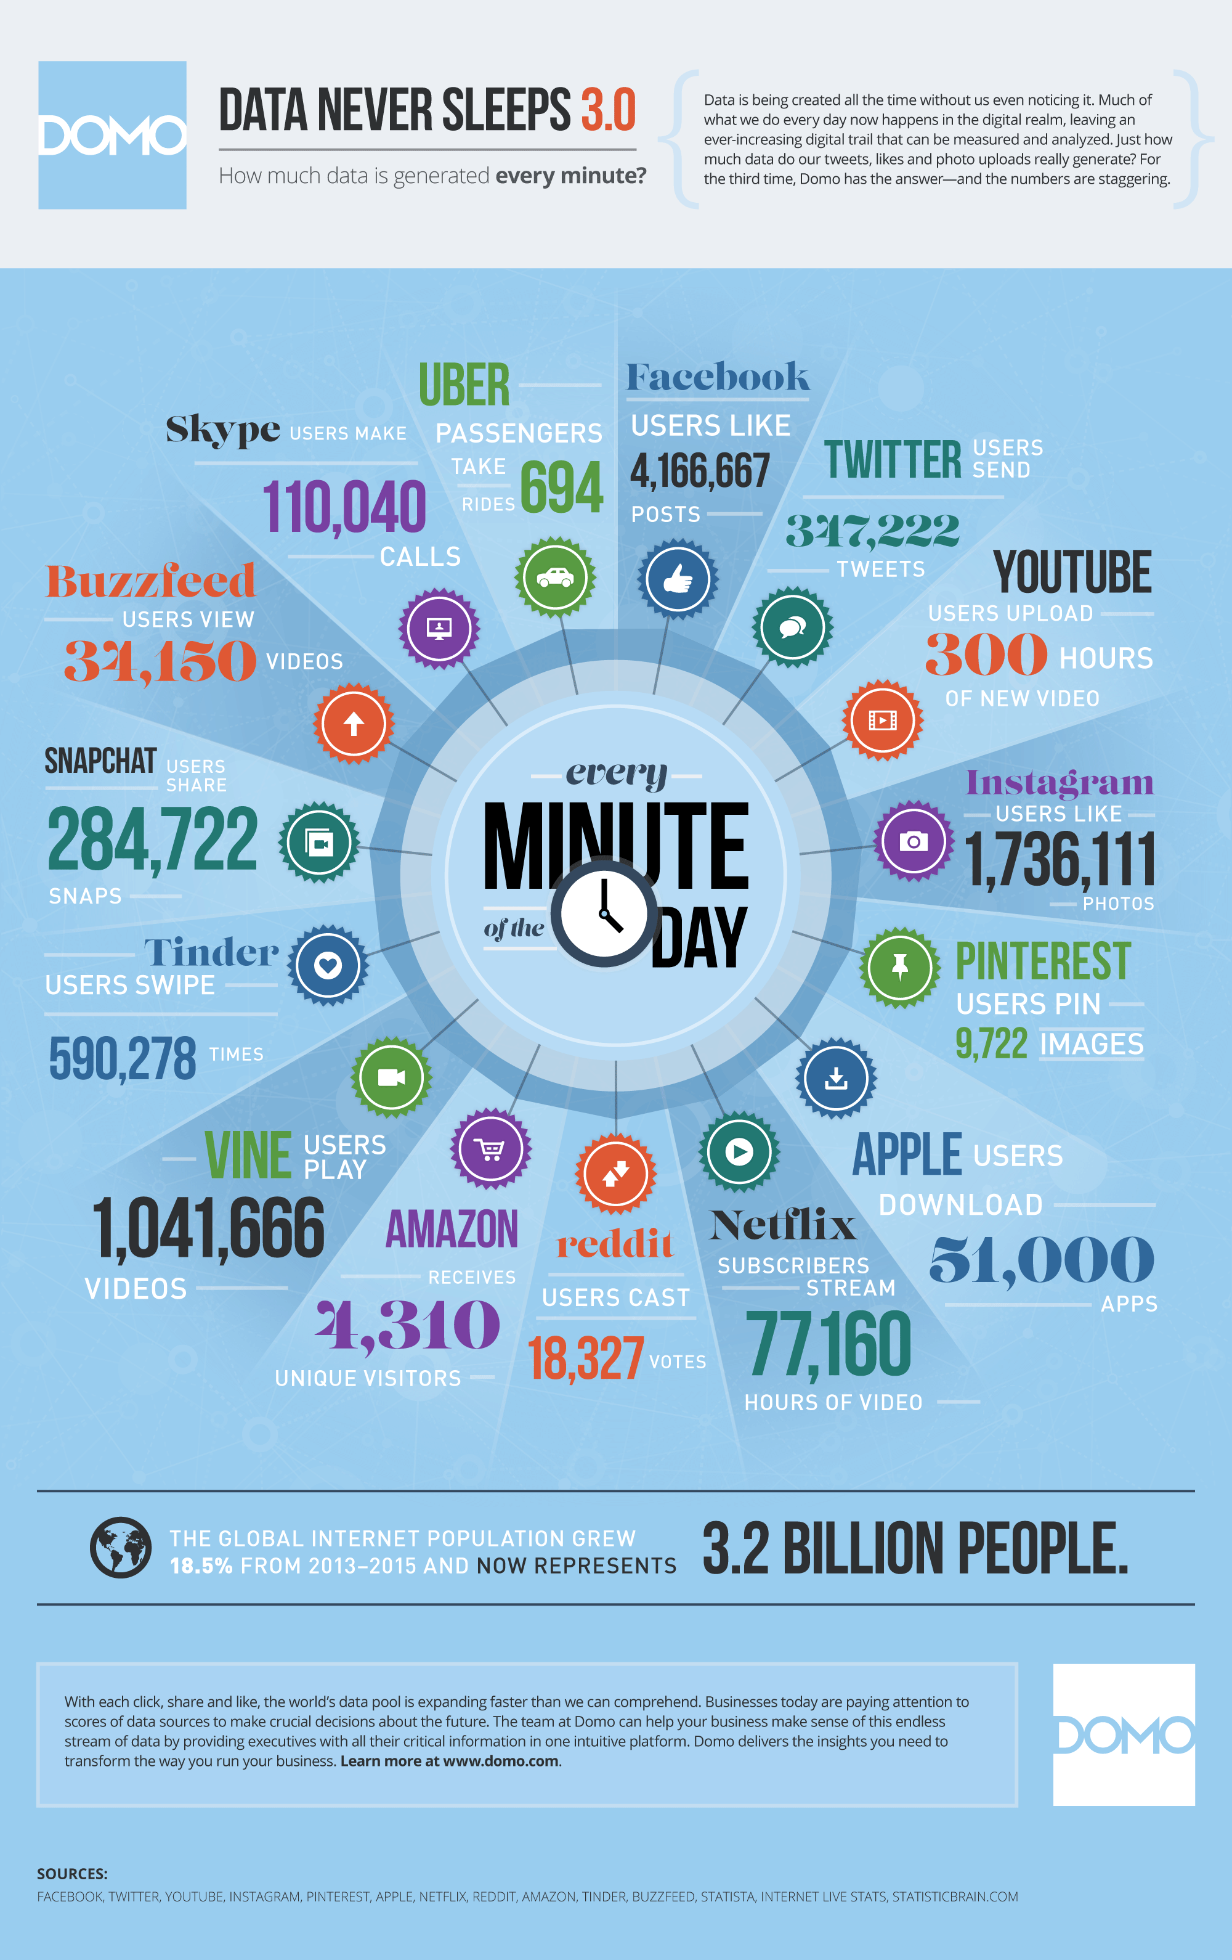
https://www.domo.com/blog/data-never-sleeps-3-0/

Slide 39
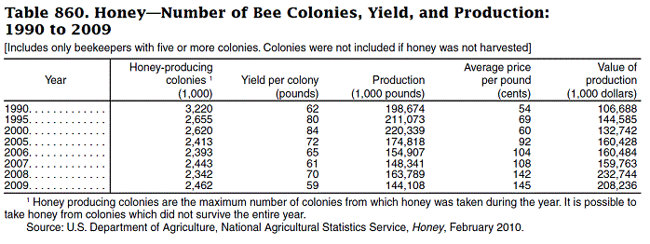
STATISTICS
Statistics are your place for quick numbers. They might answer the questions "how much" or "how many." Statistics result from data that have been interpreted.
Statistics can be in the form of numbers or percentages and they are frequently presented in a table or graph.
A statistical table might look like this one from the Statistical Abstract of the United States:

Slide 40
Evaluating Data and Statistics
Some Questions to Think About When Locating Data or Statistics
Time Period Are you looking for the current year? Remember that is takes some time to compile data. A range of years? Do you need historical data?
Geography What country, state, county, etc., might compile the data you want?
Sources
databases, government agencies, researchers, research collections like
Availability
What data is likely to be available?
Location
Where is the data likely to be located?

Slide 41
Where to find data
T’internet!
UK Data archive: The UK's largest collection of digital research data in the social sciences and humanities
http://www.data-archive.ac.uk/

Slide 42

RAND Database of terrorist incidents
http://www.rand.org/nsrd/projects/terrorism-incidents/about.html

Slide 44
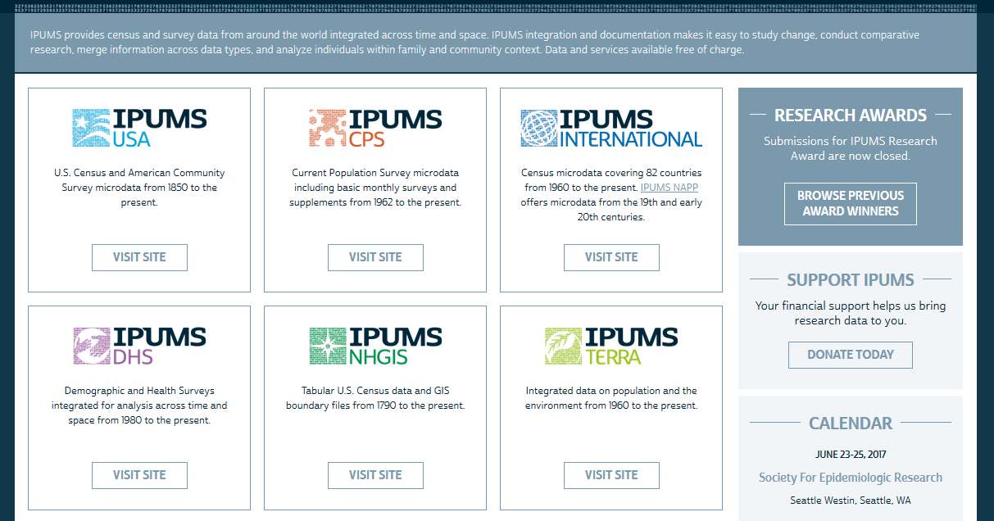
IPUMS International Census Data
https://www.ipums.org/

Slide 45

European Social Survey
http://www.europeansocialsurvey.org/

Slide 46
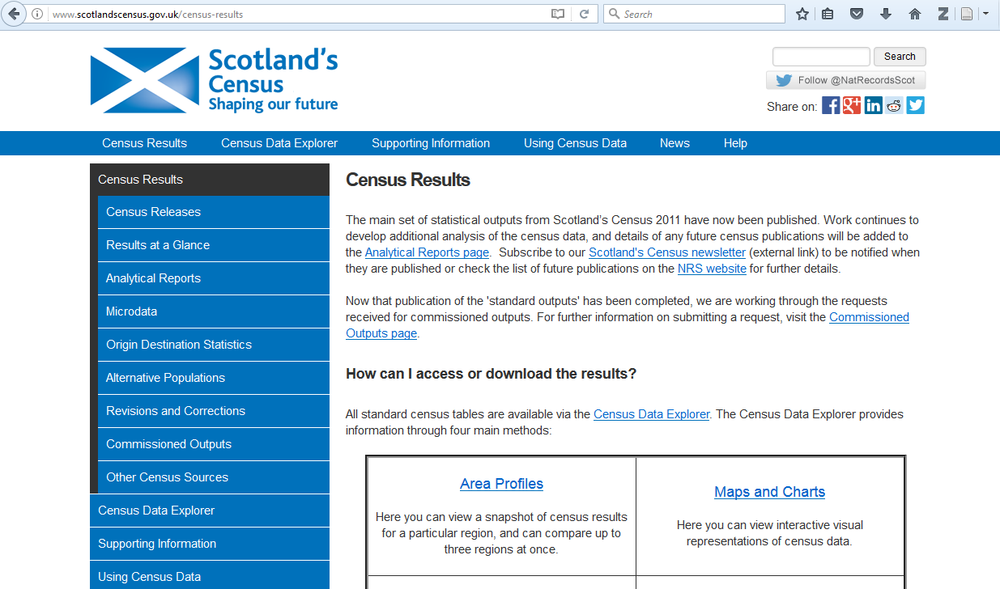
Some Scottish Census data
http://www.scotlandscensus.gov.uk/census-results

Slide 47
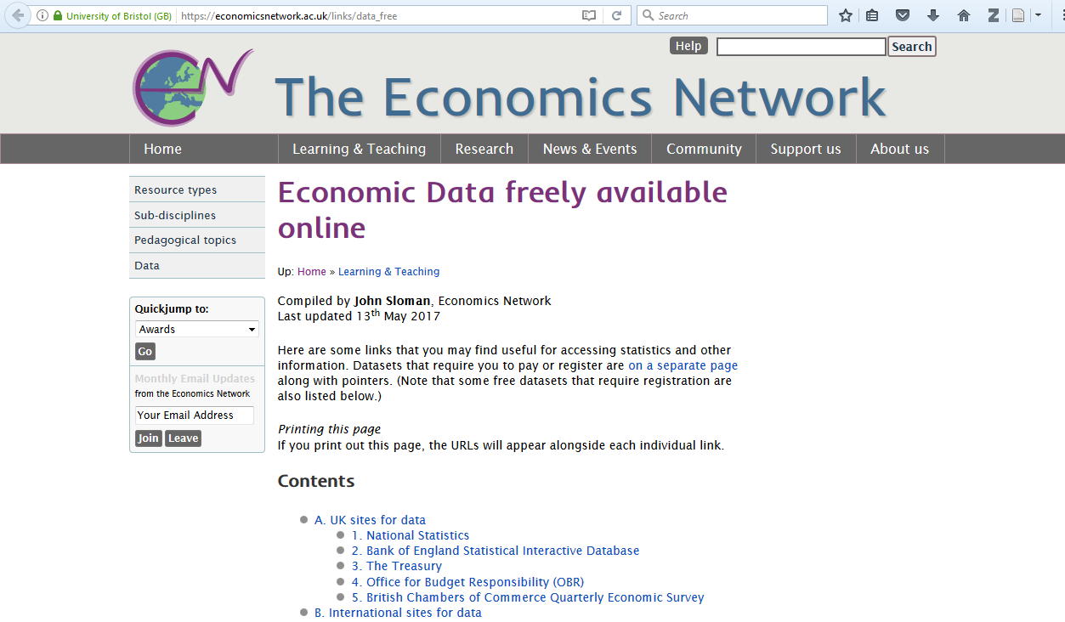
Some Economics Data
https://economicsnetwork.ac.uk/links/data_free

Slide 48
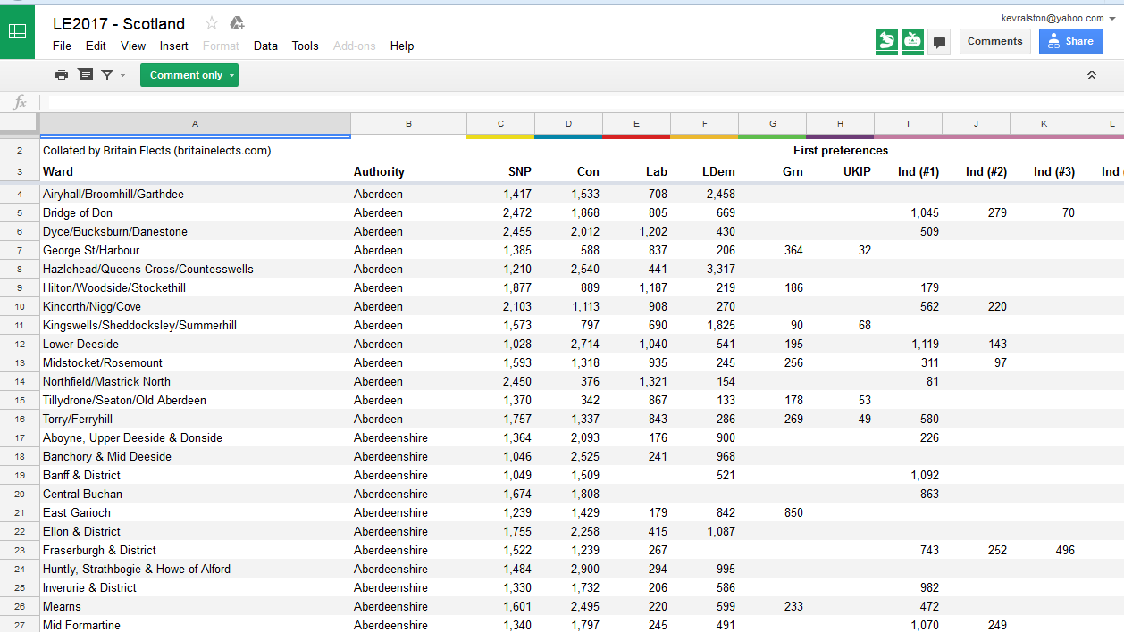
Political data e.g. Council election results
E.g. http://britainelects.com/results/may2017/

Slide 49
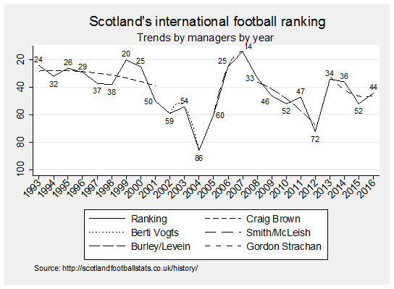
Sports
Lots of data available… everywhere…

Slide 50

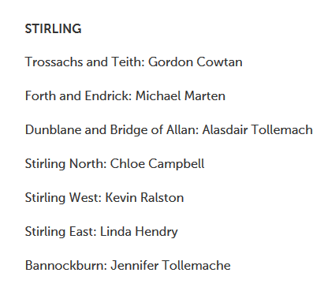
Politics- loads of data available…

Slide 52
Those are some ideas:
You’re welcome to study anything within reason
Nothing illegal – you doing illegal things
Nothing (actually) criminal – i.e. involving observing other people doing criminal things (secondary crime data is okay)
Nothing life threatening please!
Don’t go and do primary data collection on dangerous subjects please!

Slide 53
Course Work 2, write a short piece of replicable analysis
Write a syntax (SPSS programming) file that reads in organises, and does a piece of analysis on data.
Write a short report on the analysis you did.
Less than 2000 words
refer to other research and literature from the field (whatever it is)

Slide 54
http://abacus.bates.edu/~ganderso/biology/resources/writing/HTWsections.html
What is the problem? | Introduction
How did I solve the problem? | Materials and Methods
What did I find out? | Results
What does it mean? | Discussion
 | References
See, how to write a paper in a scientific format: http://abacus.bates.edu/~ganderso/biology/resources/writing/HTWsections.html

Slide 55
Lesson 2: course document
Lab: Lesson2 this is a lab on recoding variables, data operationalisation tasks which all analyses need to do.
Additional material:
Have a look at these web pages on data and data sources:
What are data and where to find it?
http://elon.libguides.com/data
Some data sources:
http://elon.libguides.com/c.php?g=331454&p=2224517
http://elon.libguides.com/c.php?g=331454&p=2227698
Work through this course, it introduces data analysis and SPSS
Learning to analyse quants data:
http://archive.learnhigher.ac.uk/analysethis/main/quantitative.html
A tutorial on SPSS syntax is below:
http://libguides.library.kent.edu/SPSS/Syntax

Slide 56
Lecture 3 Types of variables
And ways to look at (analyse) them

Slide 57
Recap: week 1
We’ve heard about the research process
We’ve heard about data that is out there
We’ve opened up SPSS
We’ve opened up data
We’ve looked at how to get data into SPSS –
paths (entering it in by hand)
We’ve looked at how to organise and recode (manage) data and start to look at it

Slide 58
Course work 1: now due Tues 27th June
Produce a research proposal <1000 wds
A research proposal is a concise and coherent summary of your proposed research. It sets out the central issues or questions that you intend to address. It outlines the general area of study within which your research falls, referring to the current state of knowledge and any recent debates on the topic.
A research proposal:
Title
Abstract
Research Context
Research Questions
Research Methods
Significance of Research
Bibliography

Slide 59
This week:
We have got data into SPSS,
We have started to look at and organise the data
This week we will look a bit more at the basics of analysing data
In this lesson we will think about types of data … and
simple analyses appropriate for these
We will look at a core concept in analysis, the measurement of association

Slide 60
Before we get onto that:
A bit of active learning….
Learning to analyse quants data:
Link on lesson 2
http://archive.learnhigher.ac.uk/analysethis/main/quantitative.html

Slide 61
Types of data…

Slide 62
To undertake analysis we need data
We have previously seen the sources of some data
E.g. data collected and made available on the UK data archive
http://www.data-archive.ac.uk/
There are many other sources of data and you’re welcome to work with any type you like on this course
Although it is probably a bit ambitious to collect original data
Indeed even finding good secondary data can be a time consuming task
Then there is cleaning and organising it
The easiest option is to use ghs95.sav data we use on this course
But don’t feel you cant use other data

Slide 63
Variables
We’ve got data
Datasets are made up of variables
Variables
Things that vary
a characteristic of interest for each person or thing in a population

Slide 64
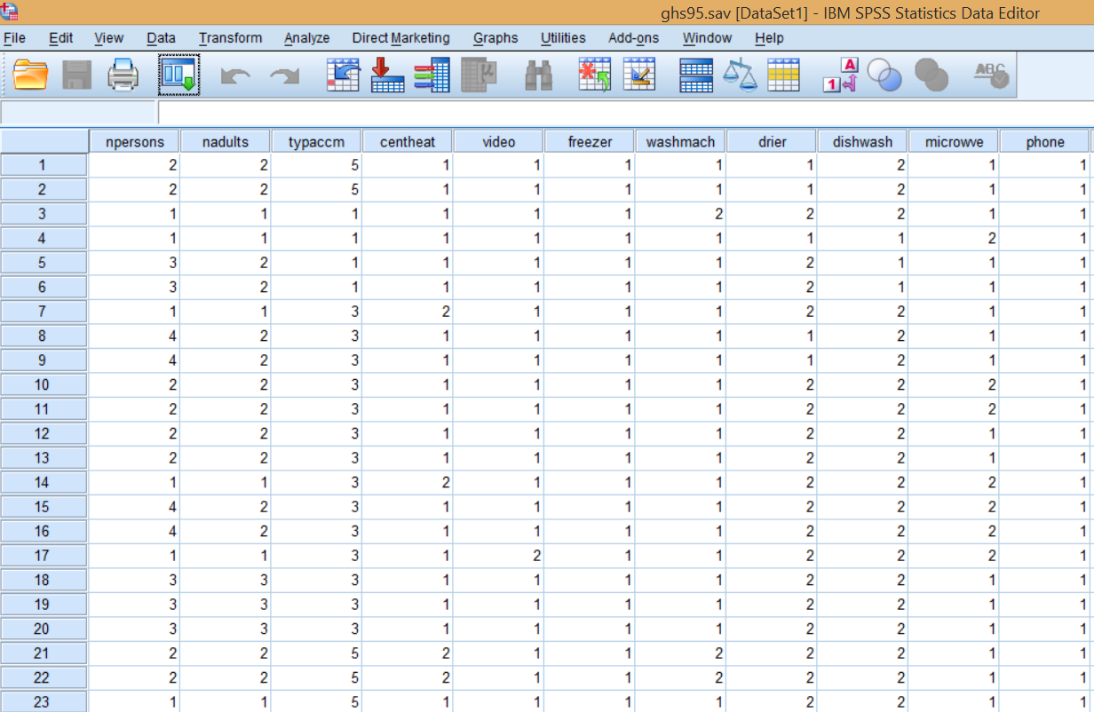

Slide 65
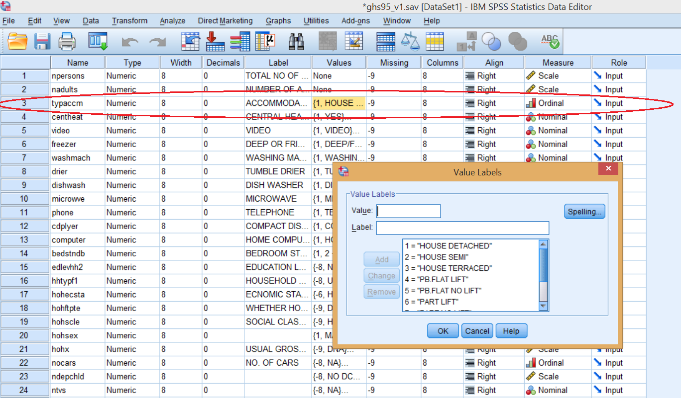

Slide 66
Types of variables
Data
Numerical
(Quantitative)
Categorical
(Qualitative)
e.g. age weight, number of children, shoe size
e.g.
Eye colour, gender, blood type, ethnicity

Slide 67
Data
Numerical
(Quantitative)
Categorical
(Qualitative)
Continuous
(ratio)
Discrete (interval)
Ordinal, categories you can rank
Nominal, categories without order or direction
Height, weight, age, income
Temperature
e.g. educational attainment, satisfaction
e.g. gender
Marital status

Slide 68
Interval and ratio
A interval variable is a measurement where the difference between two values is meaningful. The difference between a temperature of 100 degrees and 90 degrees is the same difference as between 90 degrees and 80 degrees.
ratio variable, has all the properties of an interval variable, and also has a clear definition of 0.0.
Like money, it makes sense to talk of someone having no money.
But it is not sensible to talk of their being no temperature
Temp in Farenheit and Celsius, 0 does not mean no heat.
It does in Kelvin thought, which is a ratio measure

Slide 69
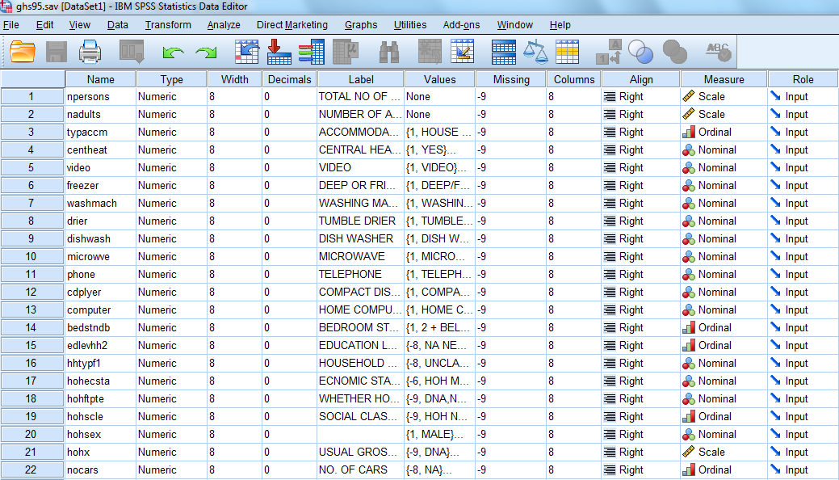

Slide 70
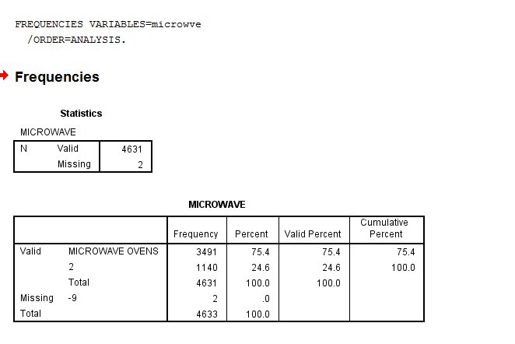
Nominal Variable in SPSS: have a microwave?

Slide 71
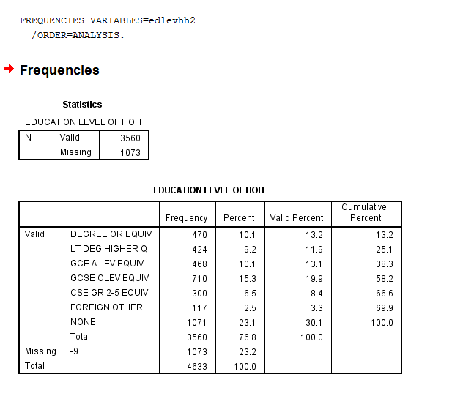
Ordinal variable SPSS: education level

Slide 72
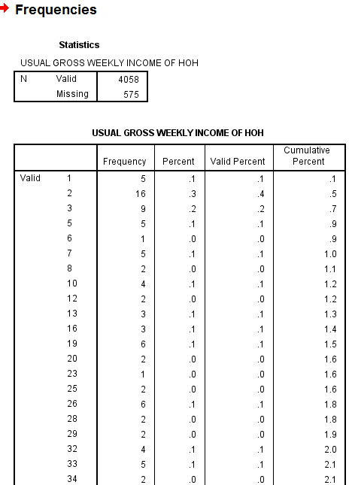
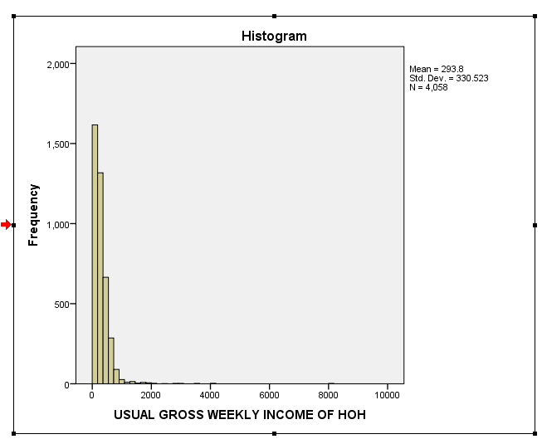
Scale (interval/ratio) SPSS:
FREQUENCIES VARIABLES=hohx
/HISTOGRAM
/ORDER=ANALYSIS.

Slide 73
Measures of central tendency: describing data
Mean
the arithmetic average.
AVERAGE SCORE IN A DISTRIBUTION.
APPROPRIATE FOR INTERVAL/RATIO DATA
The MOST SENSITIVE and MOST USEFUL measure of Central Tendency
Mode
number that occurs most frequently
APPROPRIATE FOR NOMINAL DATA to describe which category occurs MOST?)
Median
divides the distribution exactly in half (at the 50th percentile)
literally, the MIDDLE CASE
APPROPRIATE FOR ORDINAL DATA
Not swayed by Extreme Scores (OUTLIERS)

Slide 74
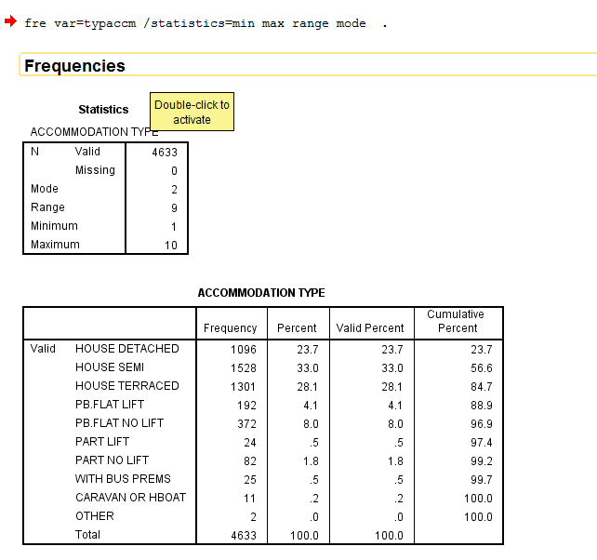
Describing a nominal variable: Mode the category with the most cases

Slide 75
Describing an ordinal variable: Median the 50th percentile
http://onlinestatbook.com/2/introduction/percentiles.html
A test score in and of itself is usually difficult to interpret.
For example, if you learned that your score on a measure of shyness was 35 out of a possible 50, you would have little idea how shy you are compared to other people.
More relevant is the percentage of people with lower shyness scores than yours. This percentage is called a percentile.
If 65% of the scores were below yours, then your score would be the 65th percentile.

Slide 76
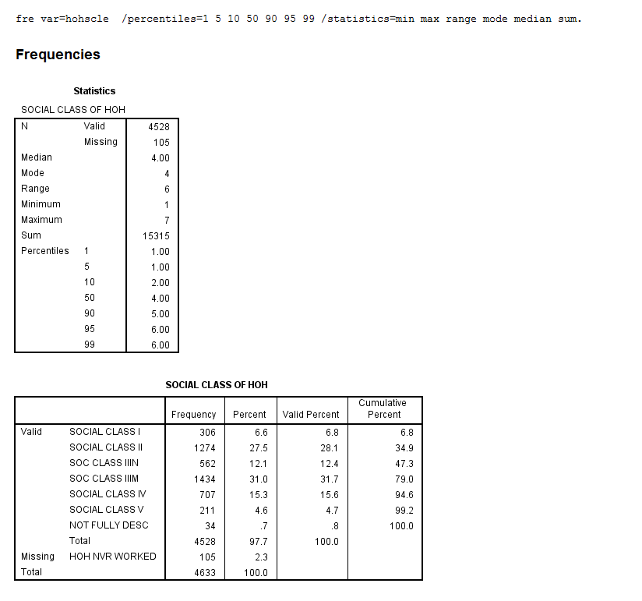

Slide 77
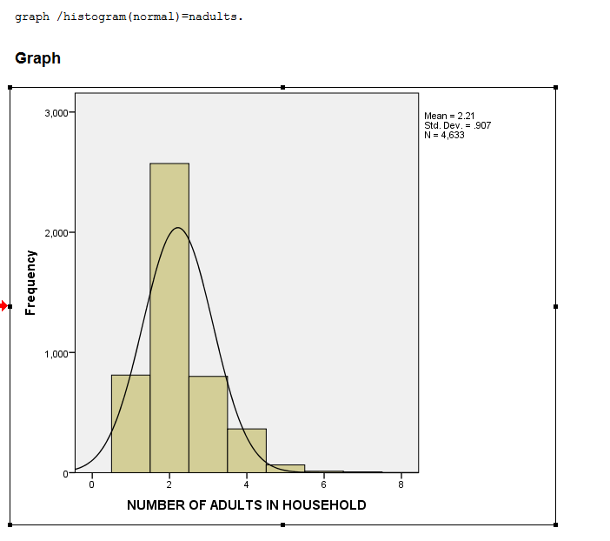
Describing a continuous variable: Mean the arithmetic mean
Number of adults in a household,
interval variable count with a limited
range of categories

Slide 78
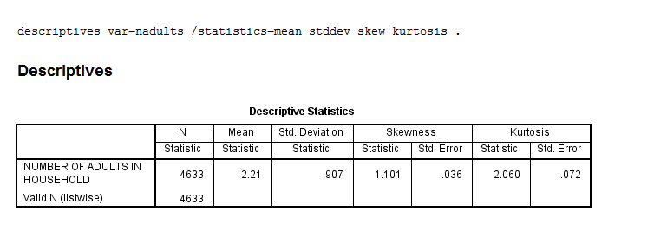
Mean number of adults:

Slide 79
Skewness
Skewness is usually described as a measure of a variables symmetry – or lack of symmetry. A perfectly symmetrical data set will have a skewness of 0. The normal distribution has a skewness of 0.
Kurtosis
Most often, kurtosis is measured against the normal distribution.
If the kurtosis is close to 0, then a normal distribution is often assumed
If the kurtosis is less than zero, then the distribution has light tails and is called a platykurtic distribution.
If the kurtosis is greater than zero, then the distribution has heavier tails and is called a leptokurtic distribution.
https://www.spcforexcel.com/knowledge/basic-statistics/are-skewness-and-kurtosis-useful-statistics#skewness

Slide 80
You don’t really see skewness or kurtosis anywhere…
Dr Wheeler:
“In short, skewness and kurtosis are practically worthless. Stewhart made this observation in his first book. The statistics for skewness and kurtosis simply do not provide any useful information beyond that already given by the measures of location and dispersion."

Slide 81
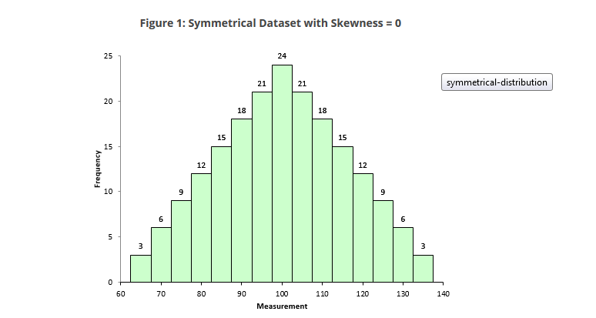

Slide 82
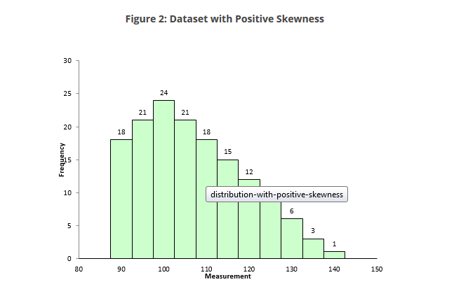
The skewness for this dataset is 0.514. A positive skewness indicates that the size of the right-handed tail is larger than the left-handed tail.

Slide 83
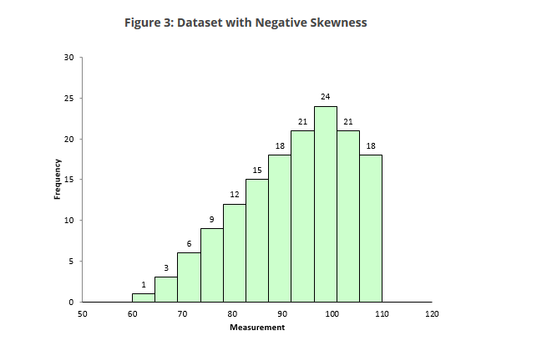
The skewness is -0.514.

Slide 84
General interpretation
If the skewness is between -0.5 and 0.5, the data are fairly symmetrical
If the skewness is between -1 and – 0.51 or between 0.51 and 1, the data are moderately skewed
If the skewness is less than -1 or greater than 1, the data are highly skewed

Slide 85
Normal distribution
Characteristics of a typical normal curve:
bell-shaped with points of inflection at μ ± σ
All normal curves are symmetric about the mean μ.
The area under an entire normal curve is 1.
All normal curves are positive for all x. That is, f(x) > 0 for all x.
The height of any normal curve is maximized at x = µ
The shape of any normal curve depends on its mean μ and standard deviation σ.

Slide 86
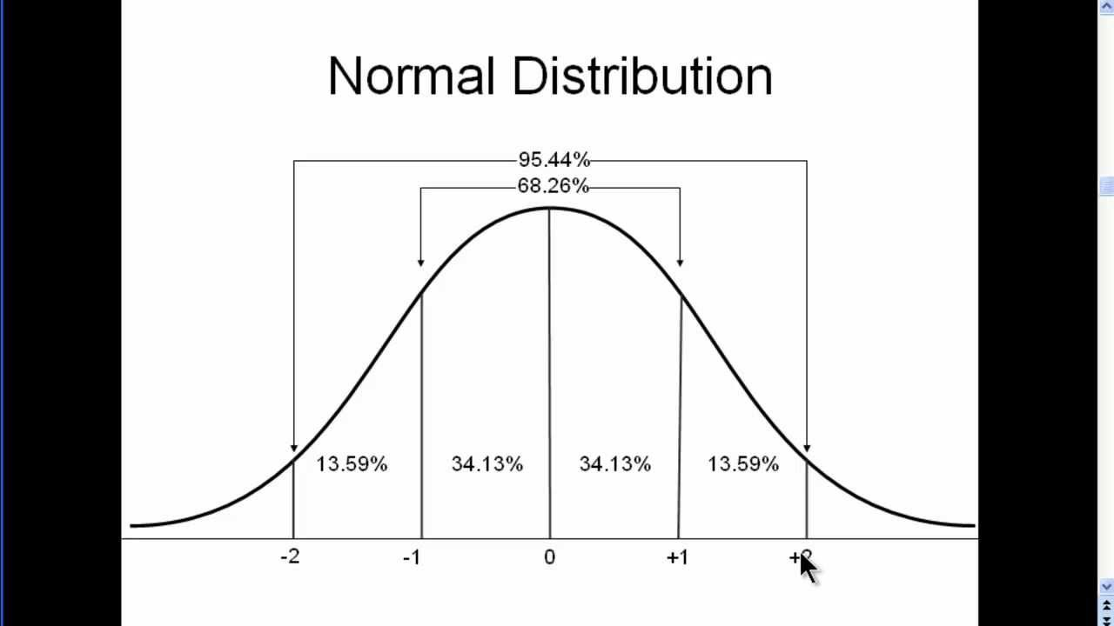

Slide 87
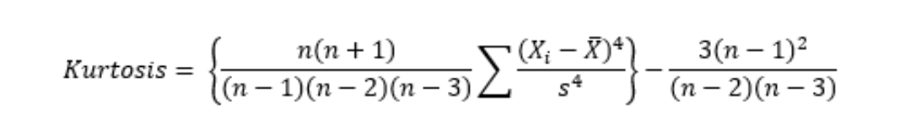
Kurtosis
Dr. Wheeler defines kurtosis as:
“The kurtosis parameter is a measure of the combined weight of the tails relative to the rest of the distribution.”
With this equation, the kurtosis of a normal distribution is 0.
https://www.spcforexcel.com/knowledge/basic-statistics/are-skewness-and-kurtosis-useful-statistics#kurtosis

Slide 88
What you need to know…
If the the kurtosis is close to 0, then a normal distribution is often assumed
These are called mesokurtic distributions
If the kurtosis is less than zero, then the distribution is light tails and is called a platykurtic distribution
If the kurtosis is greater than zero, then the distribution has heavier tails and is called a leptokurtic distribution

Slide 89
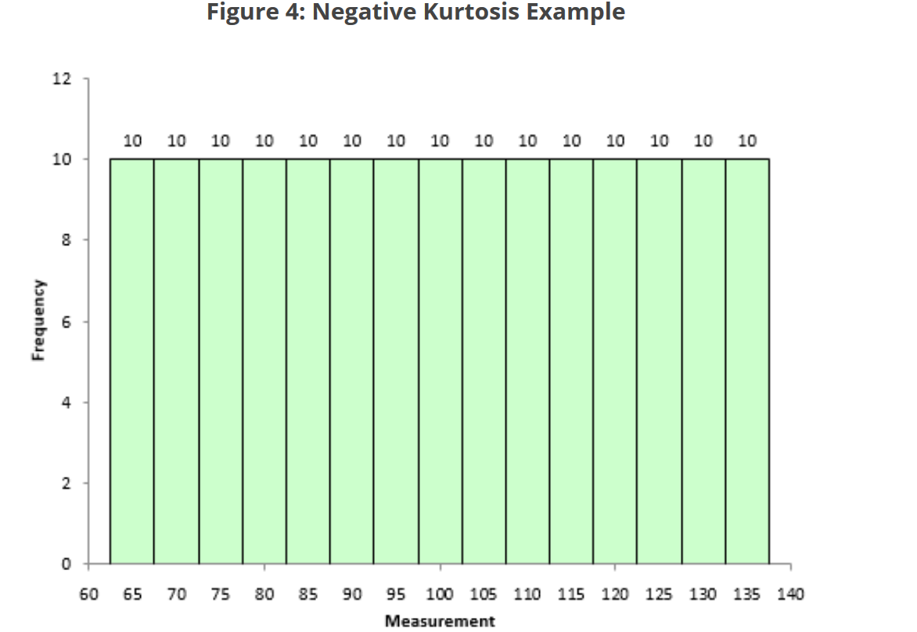
Extreme case of ‘light-tailed’, platykurtic distribution, kurtosis of: -1.21

Slide 90
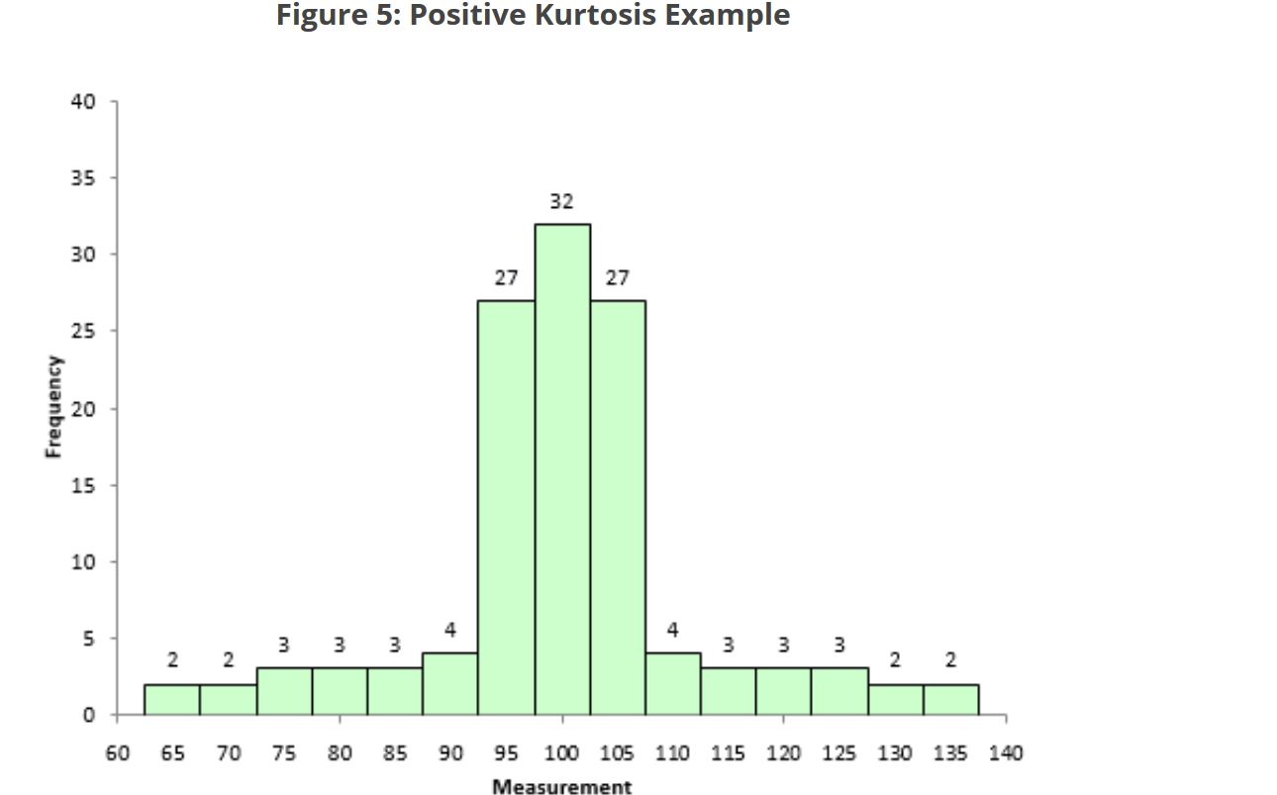
A ‘heavy tailed’ leptokurtic distribution, kurtosis of: 1.86.

Slide 91
You don’t really see skewness or kurtosis reported in papers, its something checked in the background
I’m telling you about it because its in all the text books!!!!!!!
We will think about distributions a lot more though
This is a bit of an intro to distributions
Normal distributions are very important,
The distribution of a variable dictates what statistics we use
Dr Wheeler:
“In short, skewness and kurtosis are practically worthless. Stewhart made this observation in his first book. The statistics for skewness and kurtosis simply do not provide any useful information beyond that already given by the measures of location and dispersion."

Slide 92
Lecture 4 Chi-Square, correlation and regression
Association

Slide 93
Recap – from Tuesday
We heard about different types of variables (more in a second)
We started to think of ways appropriate to analyse/describe these
E.g. Mean, Mode and Median
We started to think about distributions. How data is distributed on variables
We saw the Normal Distribution
68-95-99.7, 68% of cases within 1 standard deviation of the mean
We heard about skew and kurtosis
Skew- whether one tail of the distribution is longer than the other
Kurtosis, whether the tails are lighter or heavier

Slide 94
Data
Numerical
(Quantitative)
Categorical
(Qualitative)
Continuous
(ratio)
Discrete (interval)
Ordinal, categories you can rank
Nominal, categories without order or direction
Height, weight, age, income
Temperature
e.g. educational attainment, satisfaction
e.g. gender
Marital status

Slide 95
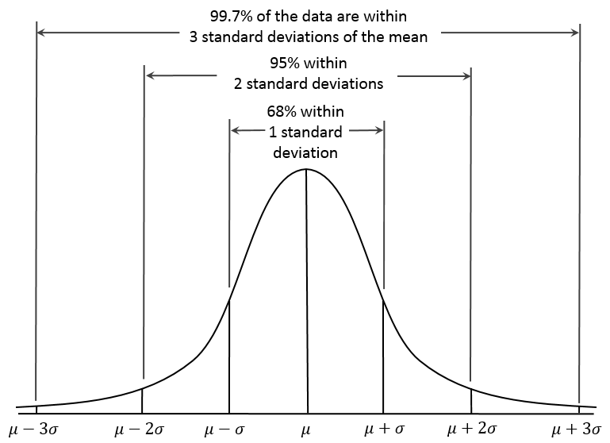
By Dan Kernler - Own work, CC BY-SA 4.0, https://commons.wikimedia.org/w/index.php?curid=36506025

Slide 96
Association between 2 categorical variables
Example from Agresti and Franklin, Statistics the Art and Science of Learning from Data
Are pesticides present less often in organic food?

Slide 97
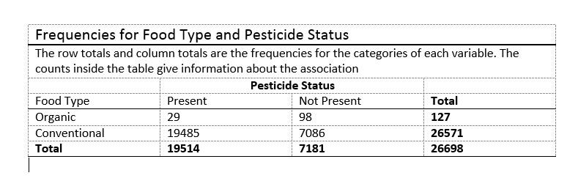
Outcome variable
Explanatory variable

Slide 98
Lets unpack this table
Proportion of organic food types which contain pesticides:
29/127= 0.228
Proportion of conventional food types containing pesticides:
19485/26571= 0.733
3 times higher
Or, 0.733/0.228=3.2

Slide 99
This is a contingency table: displays two categorical variables, one in the row one in the column
The process of finding frequencies for the cells of a contingency from a dataset is called cross-tabulation (this is the term used in SPSS).

Slide 100
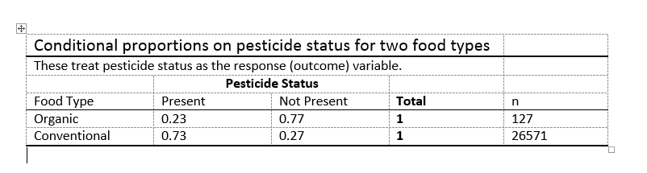
Conditional proportions
The proportion of Pesticides conditional on food type
Suggests an association

Slide 101
Chi-square test
A method for assessing whether patterns in contingency tables are meaningful or not.
Tests whether categorical variables are independent or associated.
https://davidwees.com/content/teaching-chi-squared-test/

Slide 102

Do you watch Game of Thrones?

Slide 103
Do you watch Game of Thrones?
Lets say we have a sample of 200
n=200
Lets say its 50% men 50% women
So, 100 men
100 women

Slide 104
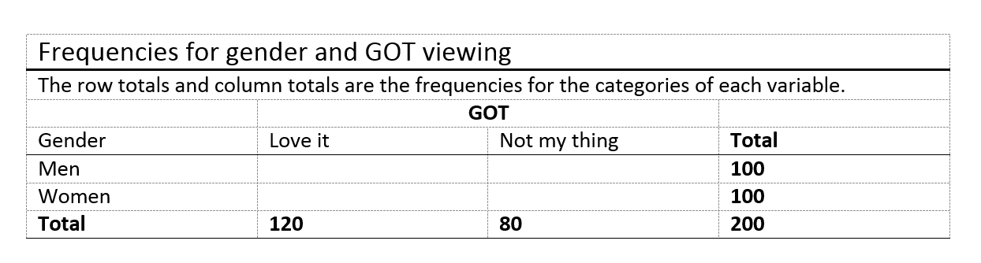
Do you watch Game of Thrones? (GOT)
60
40
60
40
If gender is not associated with (is independent of) GOT viewing what would we expect the values in the cells to be, given what we know from row and column totals

Slide 105
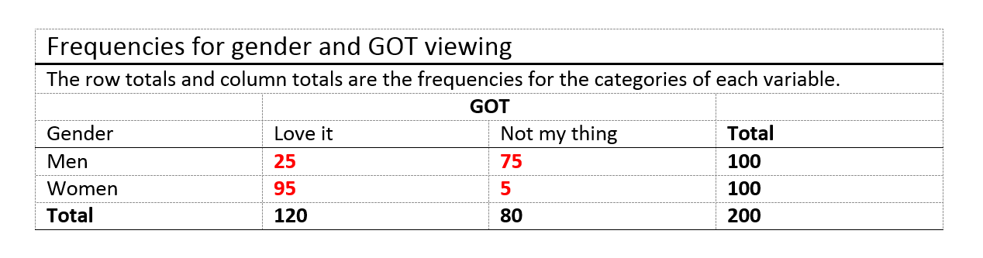
That is what we would expect given an assumption of independence, what do we observe?
Is there a relationship between gender and GOT viewing in the observed data?
How much different do the observed data have to be from expected for their to be a significant relationship?

Slide 106
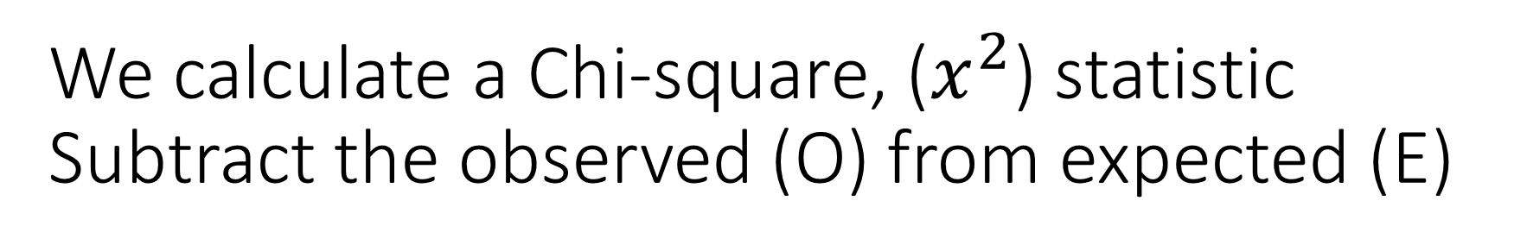
We calculate a Chi-square, ($x^{2}$) statistic Subtract the observed (O) from expected (E)
25 men love it, we expected 60
95 women love it, we expected 60
75 men say it isn’t their thing, we expected 40
5 women say it isn’t their thing, we expected 40
O | E | 0 - E
25 | 60 | -35
75 | 40 | 35
95 | 60 | 35
5 | 40 | -35

Slide 107
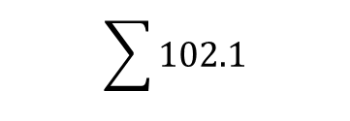
Square the O-E, gets rid of negatives
Divide by the expected count, in order to get to a sensible number
O | E | 0 - E
25 | 60 | -35
75 | 40 | 35
95 | 60 | 35
5 | 40 | -35
(0 – E)^2
1225
1225
1225
1225
(0 – E)^2/E
20.42
30.63
20.42
30.63
$$\sum{102.1}$$

Slide 108
Degrees of freedom
Degrees or freedom (DF) are the number of values that are ‘free to vary’
minimum number of independent coordinates (values) that can specify the position of the system completely
In the chi-square test for categorical association this is:
(rows-1) * (colums-1)
1 DF
25
75

Slide 109
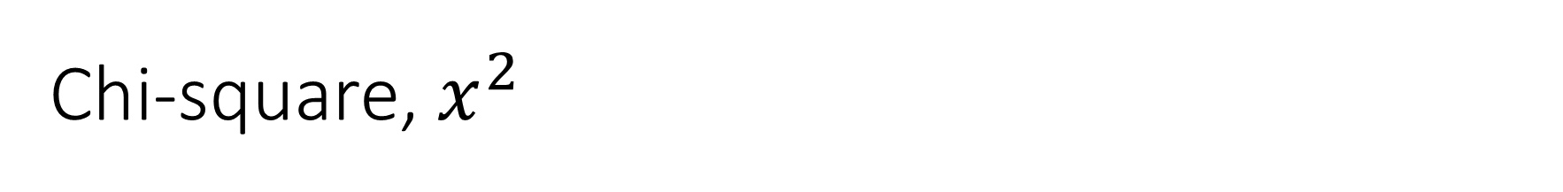
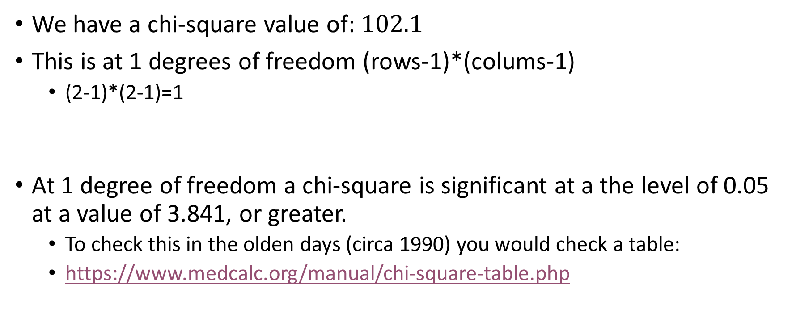
Chi-square, $x^{2}$
We have a chi-square value of: $102.1$
This is at 1 degrees of freedom (rows-1)*(colums-1)
(2-1)*(2-1)=1
At 1 degree of freedom a chi-square is significant at a the level of 0.05 at a value of 3.841, or greater.
To check this in the olden days (circa 1990) you would check a table:
https://www.medcalc.org/manual/chi-square-table.php

Slide 110
Significance
Statistical significance has a specific technical meaning
This is about the probability of rejecting the null hypothesis
We are not going to go into that right now

Slide 111
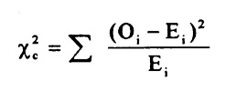
Good news
Data analysis packages do all of this stuff for us!
This is the formula we just calculated:

Slide 112
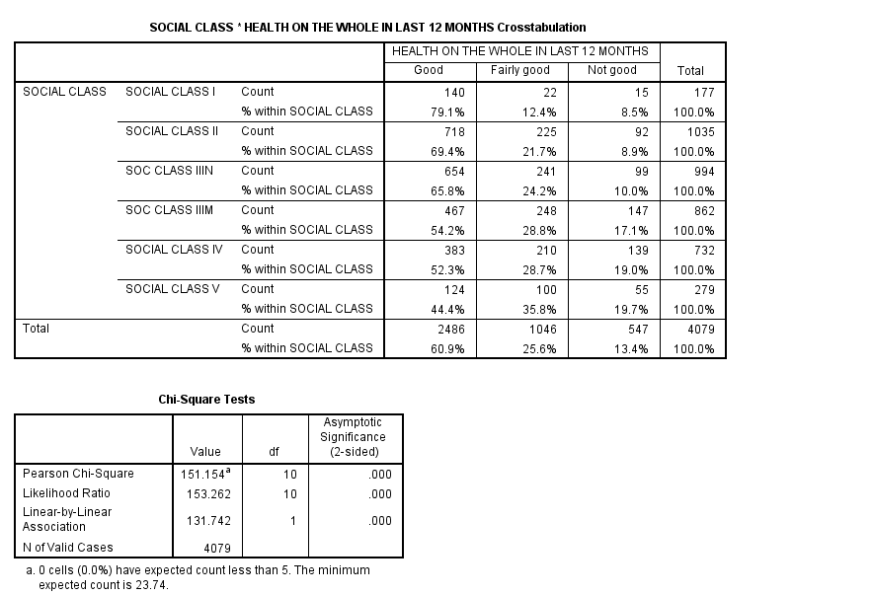
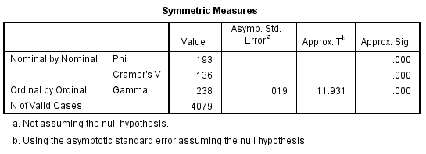
missing values soclase (-9,7).
cro tables=soclase by genhlth /cells=count row /statistics=chi phi gamma.

Slide 113
Metric associations
To view categorical associations we might use a contingency table
For metric associations we might use a scatter plot:
In SPSS
compute lnearn=-999.
if (earnings ge 10 & earnings le 5000) lnearn=ln(earnings).
missing values lnearn (-999).
graph /scatterplot=workhrs with lnearn.

Slide 114
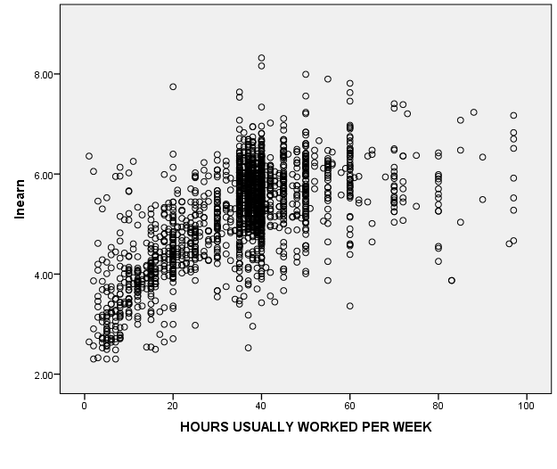
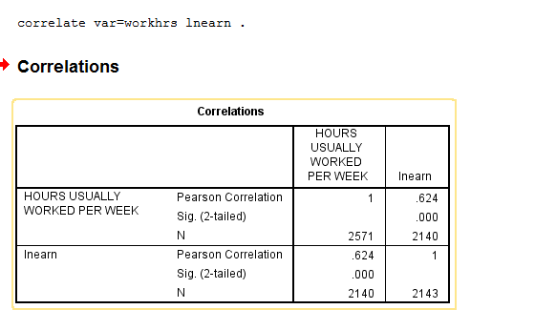

Slide 115
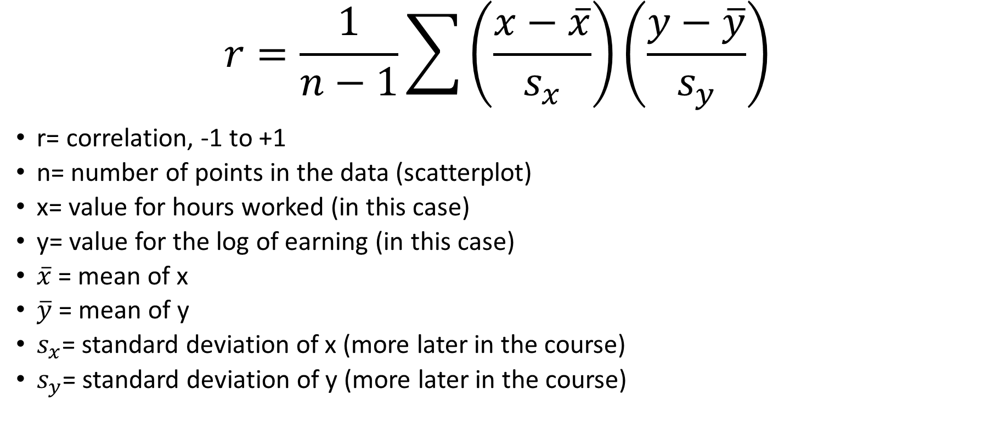
Calculating the correlation (r), arghhhh not more maths!!!!!!
$$r=\frac{1}{n−1}\sum{\left(\frac{x−\overline{x}}{s_{x}}\right)}\left(\frac{y−\overline{y}}{s_{y}}\right)$$
r= correlation, -1 to +1
n= number of points in the data (scatterplot)
x= value for hours worked (in this case)
y= value for the log of earning (in this case)
$\overline{x}$ = mean of x
$\overline{y}$ = mean of y
$s_{x}$= standard deviation of x (more later in the course)
$s_{y}$= standard deviation of y (more later in the course)

Slide 116
Not going to say any more
Agresti and Franklin (2007)
Hand calculation of the correlation (r) is tedious. Use software. Its more important to understand how correlation describes the association
1 = complete positive association
0 = no correlation
-1= complete negative association
http://www.dummies.com/education/math/statistics/how-to-calculate-a-correlation/

Slide 117
Rule of thumb
Exactly –1. A perfect downhill (negative) linear relationship
–0.70. A strong downhill (negative) linear relationship
–0.50. A moderate downhill (negative) relationship
–0.30. A weak downhill (negative) linear relationship
0. No linear relationship
+0.30. A weak uphill (positive) linear relationship
+0.50. A moderate uphill (positive) relationship
+0.70. A strong uphill (positive) linear relationship
Exactly +1. A perfect uphill (positive) linear relationship

Slide 118


Slide 119

Curvilinear relationship: r=0, but the association is strong

Slide 120
Regression

Slide 121

Regression: predicting an outcome
$\hat{y}=a+bx$
Regression line predicts the value of an outcome variable y
This is a straight line function of the value of x
$\hat{y}$=predicted value of y
$a$= denotes the y-intercept
b= denotes the slope of x

Slide 122

Archaeologists use regression to predict height
Sometimes anthropologists only have one bone, like a femur
They use the equation:
$\hat{y}=61.4+2.4x$
Where x=0, $\hat{y}=$ 61.4
The y intercept = 61.4
If x=50, $\hat{y}=$ 181.4
$\hat{y}=61.4+2.4\left(50\right)=181.4$
Lets try fitting a line, interactively
…. whoooo

Slide 123
Interpreting the y-Intercept
y-Intercept:
the predicted value for y when x = 0
helps in plotting the line
May not have any interpretative value if
no observations had x values near 0

Slide 124

Interpreting the Slope
Slope: measures the change in the predicted variable for every unit change in the explanatory variable
Example: A 1 cm increase in femur length results in a 2.4 cm increase in predicted height
Solves this equation of a linear slope: $\hat{y}=a+bx$

Slide 125

Slope Values: Positive, Negative, Equal to 0

Slide 126
Lecture 5 Gathering Data
Lesson 5

Slide 127
Recap
We learned about types of variable
We learned about distributions
Normal distribution
Skew
Kurtosis
We learned about methods for estimating associations between variables
Conditional probabilities, categorical by categorical variables
Chi-square, categorical by categorical
Correlation, metric by metric associations
Regression, the effect of a 1 unit change in an x var on a y var

Slide 128
Data
Numerical
(Quantitative)
Categorical
(Qualitative)
Continuous
(ratio)
Discrete (interval)
Ordinal, categories you can rank
Nominal, categories without order or direction
Height, weight, age, income
Temperature
e.g. educational attainment, satisfaction
e.g. gender
Marital status

Slide 129

Regression
$\hat{y}=a+bx$
Regression line predicts the value of an outcome variable y
This is a straight line function of the value of x
$\hat{y}$=predicted value of y
$a$= denotes the y-intercept
b= denotes the slope of x
Imagine y= ice cream sales
x= hours of sunshine a day
b= the average number of ice creams sold for a 1 unit change in x
a= the average number of ice creams sold when x=0
Lets try fitting a line, interactively
…. whoooo

Slide 130
Gathering data…
Active learning, reading:
Work through this online from the section headed Survey to Plus & Minus of Survey Methods
https://www.socialresearchmethods.net/kb/survey.php

Slide 131

Experiment
Treatments
Drug
Placebo
Intervention
Non-intervention
Convincingly demonstrates causation
https://www.wisdomjobs.com/e-university/research-methodology-tutorial-355/basic-principles-of-experimental-designs-11465.html

Slide 132
Observational study
Sample of a population
Measures a range of variables
‘Observes’ rather than ‘treats’
Common in social-research, policy, economics, human-geography, marketing, data-science, political science
Often a survey, like the GHS
Does not convincingly demonstrate cause
We measure association
Correlation is not cause
Association does not imply causation

Slide 133

Hierarchy of evidence

Slide 134

Another one

Slide 135
(Some) Types of observational data
Cross-sectional
Observation at one time point
Social Attitudes Survey
General Household Survey
Longitudinal
Observation at more than one time point
British Household Panel Survey, UK Understanding Society
ONS, Longitudinal Study
Census
Everyone in the population measured at one time point
err… the Census…
Many countries have them
https://international.ipums.org/international/
82 countries >600m cases

Slide 136
Age, period and cohort effects
A major benefit of longitudinal data (and weakness of cross sectional)
Age effects are the consequences of growing older
Currently completed fertility
Period effects are the consequences of influences that vary through time
E.g. Whether in school, whether married
cohort effects are the consequences of being born at different times
Maybe the attitudes of a generation
E.g. internet use
Helps with causal inference
https://www.mailman.columbia.edu/research/population-health-methods/age-period-cohort-analysis

Slide 137
Why observation and not RCTs?
We just can not do RCTs for everything
The Bradford Hill criteria can be useful in thinking about whether a correlation is causal?

Slide 138
Bradford hill criteria
Strength (effect size): A small association does not mean that there is not a causal effect, though the larger the association, the more likely that it is causal.^{[1]}
Consistency (reproducibility): Consistent findings observed by different persons in different places with different samples strengthens the likelihood of an effect.^{[1]}
Specificity: Causation is likely if there is a very specific population at a specific site and disease with no other likely explanation. The more specific an association between a factor and an effect is, the bigger the probability of a causal relationship.^{[1]}
Temporality: The effect has to occur after the cause (and if there is an expected delay between the cause and expected effect, then the effect must occur after that delay).^{[1]}
Biological gradient: Greater exposure should generally lead to greater incidence of the effect. However, in some cases, the mere presence of the factor can trigger the effect. In other cases, an inverse proportion is observed: greater exposure leads to lower incidence.^{[1]}
Plausibility: A plausible mechanism between cause and effect is helpful (but Hill noted that knowledge of the mechanism is limited by current knowledge).^{[1]}
Coherence: Coherence between epidemiological and laboratory findings increases the likelihood of an effect. However, Hill noted that "... lack of such [laboratory] evidence cannot nullify the epidemiological effect on associations".^{[1]}
Experiment: "Occasionally it is possible to appeal to experimental evidence".^{[1]}
Analogy: The effect of similar factors may be considered.^{[1]}
Hill, Austin Bradford (1965). "The Environment and Disease: Association or Causation?". Proceedings of the Royal Society of Medicine. 58 (5): 295–300. PMC 1898525
. PMID 14283879

Slide 139
Bradford Hill and Richard Doll (1950)
1st study to show an association between smoking and lung cancer.
Case control study
Was aware the association is not necessarily causal
Evidence built and it became the most likely explanation
1965 published their criteria
>7600 citations on Google scholar

Slide 140
Strength
Strength (effect size): A small association does not mean that there is not a causal effect, though the larger the association, the more likely that it is causal.^{[1]}

Slide 141
Consistency
Consistency (reproducibility): Consistent findings observed by different persons in different places with different samples strengthens the likelihood of an effect.^{[1]}

Slide 142
Specificity
Specificity: Causation is likely if there is a very specific population at a specific site and disease with no other likely explanation. The more specific an association between a factor and an effect is, the bigger the likelihood of a causal relationship

Slide 143
Temporality
Temporality: The effect has to occur after the cause (and if there is an expected delay between the cause and expected effect, then the effect must occur after that delay).^{[1]}
You can’t say that the fast food gave you an upset stomach if you had already started to feel unwell before you ate the pizza!

Slide 144
Biological gradient
Biological gradient: Greater exposure should generally lead to greater incidence of the effect. However, in some cases, the mere presence of the factor can trigger the effect. In other cases, an inverse proportion is observed: greater exposure leads to lower incidence.^{[1]}
Sports training might be another example

Slide 145
Plausibility
Plausibility: A plausible mechanism between cause and effect is helpful (but Hill noted that knowledge of the mechanism is limited by current knowledge)
Means, motive and opportunity
E.g. sunshine and ice creams… wouldn’t work if it was sunshine and welly boots…

Slide 146
Coherence
Coherence: Coherence between epidemiological and laboratory findings increases the likelihood of an effect. However, Hill noted that "... lack of such [laboratory] evidence cannot nullify the epidemiological effect on associations“
Is there some lab/experimental research to back your hypothese?

Slide 147
Experiment
Experiment: "Occasionally it is possible to appeal to experimental evidence".

Slide 148
Analogy
Analogy: The effect of similar factors may be considered.
Has a similar phenomena been observed elsewhere?
E.g. evolutionary theory, survival of the fittest

Slide 149
That is the Bradford Hill criteria
It is specifically developed for public health research.
Much of the criteria are directly applicable to other areas and disciplines
Worth bearing in mind, you should always think whether any observed association is causal

Slide 150

Data gathering: It’s complicated

Slide 151
Statistical Methods Sampling Techniques
From
www.statstutor.ac.uk
Based on materials provided by Coventry University and Loughborough University under a National HE STEM Programme Practice Transfer Adopters grant

Slide 152
Sampling techniques:
Non-random
Random

Slide 153
Sample surveys
Subjects included in a study can be selected using either:
A non-random sampling approach, or
A random sampling approach

Slide 154
Non-random sampling
Types:
Self-selecting samples
Convenience samples
Judgemental samples
Quota sampling: The interviewer has been given quotas to fill from specified subgroups of the population, e.g. 20 women 20-30 years old
Can all be very biased
Not representative of population

Slide 155
Random sampling
Requires:
Random sampling method
Random number generation
Sampling frame

Slide 156
Random sampling methods
Simple Random Sampling: Every member of the population is equally likely to be selected
Systematic Sampling: Simple Random Sampling in an ordered systematic way, e.g. every 100th name in the yellow pages
Stratified Sampling: Population divided into different groups from which we sample randomly
Cluster Sampling: Population is divided into (geographical) clusters - some clusters are chosen at random - within cluster units are chosen with Simple Random Sampling

Slide 157
Generating random numbers
Best way is to select numbered balls out of a bag
Or use random number generators
Many available online, e.g
www.random.org/integers
Or use Excel:
E.g. “=randbetween(1,200)”
generates a random number between 1 and 200

Slide 158
Sampling frame
A list of subjects from which a sample of subjects is selected
Examples:
Map
Census database
Employee database
Telephone directory
Need to select subjects at random
Without a sampling frame, random selection is difficult/impossible

Slide 159

Example: simple random sampling
Survey of insect population living in woodland Trees numbered 1 to 200
10 trees chosen at random

Slide 160

Example: Stratified sampling
Foot measurement study of the population of Taiwan
Total sample size of 1,000
Sample for each category selected randomly from the population

Slide 161

Example: cluster sampling
Survey of insect population living in woodland
Squares chosen at random on the grid
Trees lying within the squares chosen until 10 chosen

Slide 162
Cluster sampling v. stratified sampling
Cluster sampling:
Cheaper
Usually not representative of whole population
Stratified sampling:
Sample more representative
Good information on subgroups

Slide 163
Sampling Recap
Random sampling reduces bias
Random sampling requires:
A random sampling method
Random number generation
A sampling frame

Slide 164
Lecture 6 Distributions: *Normal Distribution*
Acknowledge Penn State online course on probability:
https://onlinecourses.science.psu.edu/stat414/node/287
Check it out if you’re interested
Acknowledge: Prof Vernon Gayle, some of the slides are his

Slide 165
Probability distributions
Guess the Probability?
Drawing an ace from a single standard pack?
Rolling a three with a (fair) single die?
Probability of tossing two heads in a row with a 50p coin?

Slide 166

Lets look a probability for a bit

Slide 167
1.0
Probabilities take on values between 0 and 1
Denoted a “p”
.5
0

Slide 168
Event will
definitely occur
1.0
.5
Event will definitely not occur
0

Slide 169
1.0
High chance
.5
Low chance
0

Slide 170


1.0
p=.50 even chance
.5
0

Slide 171
Guess the Probability?
Drawing an ace from a single standard pack?
Rolling a three with a (fair) single die?
Probability of tossing two heads in a row with a 50p coin?

Slide 172
Guess the Probability?
Drawing an ace from a single standard pack
p=.08 (4/52) or (1/13)
Rolling a three with a (fair) single die?
p=.17 (1/6)
Probability of tossing two heads in a row with a 50p coin?
p=.25 (HH; HT; TT; TH = ¼ or ½ * ½)

Slide 173
Probability distributions
1+4+3+…+250=3.2
Why probability?
Suppose that the Penn State Committee for the Fun of Students claims that the average number of concerts attended yearly by Penn State students is 2.
suppose that we take a random sample of 50 Penn State students and determine that the average number of concerts attended by the 50 students is:
1+4+3+…+2/50= 3.2
if the actual population average is 2, how likely is it that we'd get a sample average as large as 3.2?

Slide 174
Why probability?
What do you think? Is it likely or not likely? If the answer to the question is ultimately "not likely", then we have two possible conclusions:
Either: The true population average is indeed 2. We just happened to select a strange and unusual sample.
Or: Our original claim of 2 is wrong. Reject the claim, and conclude that the true population average is more than 2.

Slide 175
Why probability?
Suppose that the Penn State Parking Office claims that two-thirds (67%) of Penn State students maintain a car in State College.
Then, suppose we take a random sample of 100 Penn State students and determine that the proportion of students in the sample who maintain a car in State College is:
69/100= 0.69
that is, 69%. Now we need to ask the question: if the actual population proportion is 0.67, how likely is it that we'd get a sample proportion of 0.69?

Slide 176
Why probability?
What do you think? Is it likely or not likely? If the answer to the question is ultimately "likely," then we have just one possible conclusion: The Parking Office's claim is reasonable. Do not reject their claim.
in order to use a random sample to draw a conclusion about a population, we need to be able to answer the question "how likely...?", that is "what is the probability...?".

Slide 177
Why probability?
Any time we want to answer a research question that involves using a sample to draw a conclusion about some larger population, we need to answer the question
"how likely is it...?“
"what is the probability...?“
To answer such a question, we need to understand probability, probability rules, and probability models.
These issues underlie this course

Slide 178
Normal Distribution

Slide 179
Normal distribution
A normal distribution can be characterised by its mean (μ)and standard deviation (σ)
68% of the data are within 1 σ of the μ .68 probability that a data point is 1 σ from the μ
95% of the data are within 2 σ of the μ .95 probability that a data point is 2 σ from the μ
99.7% of the data are within 3 σ of the μ .997 probability that a data point is 3 σ from the μ

Slide 180
Normal distribution
68-95-99.7 rule
68, 1 σ
95, 2 σ
99.7, 3 σ

Slide 181
Normal distribution
Characteristics of a typical normal curve:
bell-shaped with points of inflection at μ ± σ
All normal curves are symmetric about the mean μ.
The area under an entire normal curve is 1.
All normal curves are positive for all x. That is, f(x) > 0 for all x.
The height of any normal curve is maximized at x = µ
The shape of any normal curve depends on its mean μ and standard deviation σ.
μ= population mean
σ= (population) standard deviation

Slide 182

Normal distribution: the height of women (in the USA)
Mean (μ) = 65inches
Sd (σ) = 3.5inches

Slide 183

Normal distribution the height of women (in the USA)
Mean (μ) = 65inches
Sd (σ) = 3.5inches
μ – σ = 65 – 3.5 = 61.5
μ + σ = 65 + 3.5 = 68.5
μ – 2σ = 65 – 7= 58
μ + 2σ = 65 + 7 = 72
μ – 3σ = 65 – 10.5= 75.5
μ + 3σ = 65 + 10.5 = 54.5

Slide 184
Why the normal distribution?
There are many distributions
The normal is the most important
Many variables are normally distributed
Height
IQ
Foot size
The main reason is that methods of analysis use the normal distribution even when the data are not a bell curve (normal distribution)
The reason for this is central limit theorem

Slide 185
Exercise
Lets take a look at the distribution of variables in SPSS
Graphing the distribution using histograms
SPSS gives us the standard deviation and the mean

Slide 186
Calculating means and standard deviations
Lets have a closer look at this.

Slide 187

Lets take our data set on distributions
x=3.08
n=108

Slide 188


Sample standard deviation =s (population SD= σ)
X= value of x
$\overline{x}$= mean of x
n= sample size
$\sum{=}$just add it all up (sum)

Slide 189
Standard deviation
Measure of how spread out a distribution is
The formula is the average square root of the variance
We’ll look at this more closely in a web exercise soon:
http://www.mathsisfun.com/data/standard-deviation.html
Variance:
The average of the squared differences from the Mean.

Slide 190
Lets take our distribution
x=3.08
n=108

Slide 191
Lets take a sample from our distribution
N=108
n=10
case | Value
1 | 1
2 | 1
3 | 1
4 | 2
5 | 3
6 | 3
7 | 4
8 | 5
9 | 7
10 | 9
x | 3.6

Slide 192
First we calculate the mean difference
Value | Mean difference
1 | 1 – 3.6 = | -2.6
1 | 1 – 3.6 = | -2.6
1 | 1 – 3.6 = | -2.6
2 | 2 – 3.6 = | -1.6
3 | 3 – 3.6 = | -0.6
3 | 3 – 3.6 = | -0.6
4 | 4 – 3.6 = | 0.4
5 | 5 – 3.6 = | 1.4
7 | 7 – 3.6 = | 3.4
9 | 9 – 3.6 = | 5.4

Slide 193
Squaring the mean difference

Slide 194

Value | Mean difference
1 | 1 – 3.6 = | -2.6
1 | 1 – 3.6 = | -2.6
1 | 1 – 3.6 = | -2.6
2 | 2 – 3.6 = | -1.6
3 | 3 – 3.6 = | -0.6
3 | 3 – 3.6 = | -0.6
4 | 4 – 3.6 = | 0.4
5 | 5 – 3.6 = | 1.4
7 | 7 – 3.6 = | 3.4
9 | 9 – 3.6 = | 5.4
^2
6.76
6.76
6.76
2.56
0.36
0.36
0.16
1.96
11.56
29.16
$$\sum{66.4}$$

Slide 195
Squaring the mean difference
((-2.6)^2) + ((-2.6)^2) + ((-2.6)^2) + ((-1.6)^2) + ((-.6)^2) + ((-.6)^2) + ((.4)^2) + ((1.4)^2) + ((3.4)^2) + ((5.4)^2)) / 10-1
Divide by n-1 = 66.4/9
Variance:
= 7.3777778
(The average of the squared differences from the Mean.)
Standard deviation is the square root of this

Slide 196
Sample standard deviation
$$\sqrt{\text{7.3777778}}=2.7162065$$

Slide 197
Standard deviation: Lets look at another example
First, I’ll show you my calculation was right (hopefully!), using an online standard deviation calculator!!!!
http://www.mathsisfun.com/data/standard-deviation.html

Slide 198
Distributions
We have talked about probability
how distributions help us think about probability data takes certain values
We have introduced distributions and talked about the normal distribution
Normal distribution is one of natures beautiful patterns
shape of any normal curve depends on its mean μ and standard deviation σ.
This is important because statistical estimates are based on it
We introduced calculating standard deviations
This is a central concept in data analysis
That we will draw upon again later

Slide 199
Lecture 7 Sampling Distributions
Class-Practical

Slide 200

Thinking distributions
Means and sampling distributions
You know (we have gone through) how to calculate means, variance and standard deviations
(you knew how to do the mean already, coz you’re smart and educated)
These have equivalents in the population and a sampling distribution
Sample SD
Mean
$$\overline{x}=\frac{\sum{x}}{n}$$

Slide 201
Distributions
Population,
has a mean, a variance and a standard deviation
Sample,
has a mean, a variance and a standard deviation
Sampling (distribution)
has a mean, a variance and a standard deviation

Slide 202
Lets draw samples
We’re going to think about this by drawing samples
And having a look… and thinking…

Slide 203

A sample in a sack (bag!)

Slide 204
Lecture 8 Statistical Inference
Confidence Intervals,
Lesson 8

Slide 205
Statistical Inference
First lets look at how to calculate a confidence interval (CI)
(YOU LOVE IT, don’t lie !)
Then lets think about what it is showing us

Slide 206
Calculating a confidence interval for a sample mean
$$\overline{x}∓t_{n−1}^{∗}\frac{s}{\sqrt{n}}$$
t*-value from the t-distribution
with n – 1 degrees of freedom (where n is the sample size)
$\overline{x}$= mean
$s$ = standard deviation
n = sample size

Slide 207
Lets take our data set on distributions
x=3.08
N=108

Slide 208
Lets take a sample from our distribution
N=108
n=10
case | Value
1 | 1
2 | 1
3 | 1
4 | 2
5 | 3
6 | 3
7 | 4
8 | 5
9 | 7
10 | 9
x | 3.6

Slide 209



We want to calculate confidence intervals for a sample mean
$$\overline{x}∓t_{n−1}^{∗}\frac{s}{\sqrt{n}}$$
$s$=$\sqrt{\frac{\sum{{\left(x−\overline{x}\right)}^{2}}}{n−1}}$
$σ$ = standard deviation, s

Slide 210
Standard deviation
Measure of how spread out a distribution is
The formula is the average square root of the variance
We’ll look at this more closely in a web exercise soon:
(we won’t we did it already)
http://www.mathsisfun.com/data/standard-deviation.html
Variance:
The average of the squared differences from the Mean.

Slide 211
So we have a sample
N=108
n=10
case | Value
1 | 1
2 | 1
3 | 1
4 | 2
5 | 3
6 | 3
7 | 4
8 | 5
9 | 7
10 | 9
x | 3.6

Slide 212
First we calculate the mean difference
Value | Mean difference
1 | 1 – 3.6 = | -2.6
1 | 1 – 3.6 = | -2.6
1 | 1 – 3.6 = | -2.6
2 | 2 – 3.6 = | -1.6
3 | 3 – 3.6 = | -0.6
3 | 3 – 3.6 = | -0.6
4 | 4 – 3.6 = | 0.4
5 | 5 – 3.6 = | 1.4
7 | 7 – 3.6 = | 3.4
9 | 9 – 3.6 = | 5.4

Slide 213

Squaring the mean difference
$s$=$\sqrt{\frac{\sum{{\left(x−\overline{x}\right)}^{2}}}{n−1}}$

Slide 214

$s$=$\sqrt{\frac{\sum{{\left(x−\overline{x}\right)}^{2}}}{n−1}}$
Value | Mean difference
1 | 1 – 3.6 = | -2.6
1 | 1 – 3.6 = | -2.6
1 | 1 – 3.6 = | -2.6
2 | 2 – 3.6 = | -1.6
3 | 3 – 3.6 = | -0.6
3 | 3 – 3.6 = | -0.6
4 | 4 – 3.6 = | 0.4
5 | 5 – 3.6 = | 1.4
7 | 7 – 3.6 = | 3.4
9 | 9 – 3.6 = | 5.4
$${\left(x−\overline{x}\right)}^{2}$$
6.76
6.76
6.76
2.56
0.36
0.36
0.16
1.96
11.56
29.16
$$\sum{66.4}$$

Slide 215
Same again: Squaring the mean difference
Divide by n-1 (n=10, so n-1=9)
66.4 / 9=
Variance:
= 7.3777778
Squared mean error
Standard deviation is the square root of this

Slide 216


Sample standard deviation
$$\sqrt{\text{7.3777778}}=2.7162065$$
$s$=$\sqrt{\frac{\sum{{\left(x−\overline{x}\right)}^{2}}}{n−1}}=$
$$\sqrt{\frac{66.4}{9} }=\text{2}\text{.}\text{71}6$$

Slide 217

After all that:
$$\overline{x}∓t_{n−1}^{∗}\frac{s}{\sqrt{n}}$$
We have everything we need to calculate confidence intervals

Slide 218


$t_{n−1}^{∗}$: we get this from a t distribution table
95% confidence interval
For a sample with 9 degreed of freedom
DF = 10 -1 = 9
t*= 2.262
e.g. https://www.medcalc.org/manual/t-distribution.php

Slide 219
Some properties of the t distribution
The t distribution is bell shaped and symmetric
The distribution is slightly different at different degrees of freedom
It has thicker tails and is more spread than a standard normal distribution
The higher the degrees of freedom the closer it is to a standard normal distribution
As we are discovering: the t-score multiplied by the standard error gives the margin of error for the confidence interval for the mean
Assumes randomization, e.g. a random sample

Slide 220
History lesson
t-distribution, discovered, invented, created, found, by… William S Gosset
When working at Guinness Brewery, Dublin, circa 1908
Wanted to know the best way to brew beer. Only had small samples
Found that t-distribution worked with small sample
Methods at the time relied on large samples and a normal distribution
Published his findings under the name Student, because Guinness didn’t want people publishing in their own name!
Sometimes called Student’s t-distribution (Student’s t-test is another of his)

Slide 221

Lets do this!
$$\overline{x}∓t_{n−1}^{∗}\frac{s}{\sqrt{n}}$$
$$\overline{x}∓2.262\frac{2.716}{\sqrt{10}}$$
$2.262∗ .865$= 1.95663
This is called a standard error

Slide 222
So remember we have a sample
N=108
n=10
case | Value
1 | 1
2 | 1
3 | 1
4 | 2
5 | 3
6 | 3
7 | 4
8 | 5
9 | 7
10 | 9
x | 3.6

Slide 223
That’s it
Upper confidence interval = 3.6 + 1.96 = 5.56
Lower confidence interval = 3.6 - 1.96 = 1.64
3.6 (lci 1.64, uci 5.56)
‘True’ mean is 3.08
Hooray!
It gets better, you NEVER have to do this, unless its in a class, or test, or something:
http://www.sample-size.net/confidence-interval-mean/

Slide 224
Statistical Inference
So we have a sample mean and a confidence interval
Why do we need this?
What is the point?

Slide 225
Sample to population
We have a sample
The sample is a lot smaller than the population
But we want to say something about a population
To do this we use statistical inference
This allows us to predict whether a sample estimate (like a mean) represents the population parameter

Slide 226
Point estimates and interval estimates
There are two formal methods of making statistical inference:
Hypothesis testing (using p-values)
Confidence intervals
The most informative method of inference is to construct a confidence interval in which a population parameter is estimated to fall
The mean is a point estimate
A point estimate is a single number
A best guess at a population parameter

Slide 227
What does the confidence interval mean?
Correct interpretation
If we were to select 100 samples from the population and use these samples to calculate 100 different confidence intervals for μ (the population mean), approximately 95 of the intervals (95%) would include the true population mean.
Incorrect interpretation: The probability that the true mean (μ) is in the interval = 0.95

Slide 228
Lets do an exercise, woo hoo!
Word of warning, its going to be confusing
In the example I gave I used a t-distribution in the calculation (t* n-1)
In the example in the exercise they use a z (normal) distribution
It’s the same process and the same calculation, just a different distribution
Why?
We use the t distribution rather than the normal (z) distribution when the variance is not known and has to be estimated from sample data
This accounts for an additional source of error
So, if it’s a sample use a t-distribution, if it’s a population use a z distribution
What can I say? Leaning about statistics is confusing… but it’s a powerful method of analysis
Do the calculation again using a t-distribution

Slide 229
Lets do an exercise, woo hoo!
http://www.mathsisfun.com/data/confidence-interval.html
Explanation of when to use a t distribution or a normal (z) distribution
http://onlinestatbook.com/2/estimation/mean.html
t-distribution table:
https://www.medcalc.org/manual/t-distribution.php

Slide 230
SPSS example from the next lab (lesson 8)
Multivariate confidence interval graph…

Slide 231
Multivariate graph, with confidence intervals
** Graphically : .
sort cases by sex.
split file by sex.
graph /errorbar(CI 95)=age by genhlth by edlev2 .

Slide 232



Slide 233
Confidence interval for a mean
examine variables=workhrs /plot=none
/statistics descriptives /cinterval 95 .

Slide 234



Slide 235
Lecture 9 Statistical Significance
P-values and significance tests
Lesson 9

Slide 236
Statistical significance
Is a central concept in the analysis of quantitative data in the social sciences
Technique of analysis known as hypothesis testing, significance testing, null hypothesis statistical test (NHST)
H0 there is no such structured and systematic relationship in the data
H1 there is a structured and systematic relationship in the data
We are usually interested in generalising from samples to populations.
Classically, NHST is used to help with this

Slide 237
Teaching Point:
‘Significant’ in the context of quantitative research methods has a specific technical meaning. When writing essays we often use it as a synonym for ‘important’, do not do this on a QM course.

Slide 238
Problem: we have a sample, but we want to say something about the population
But it is the population that we are interested in not the sample
Underlying statistical significance is sampling theory
A random sample
Theoretically
Randomly taken from a specified population
Every member has an equal and known chance of being sampled
Sampling one member does not alter the chances of sampling another

Slide 239
Teaching point:
Random sample means that all members of a population have and equal and known chance of being sampled.
Not to be confused with other meanings of random, such as: ‘without definite aim, purpose, method’

Slide 240
Analysis
We have a random sample of a population
We want to know about the relationship between one variable and another
X and Y
Or the relationship between a set of variables x1, x2, x3… and an outcome, Y
We might undertake regression analysis:

Slide 241
Standard errors
Standard error is a measure of accuracy of an estimate, square root of the standard deviation
$$σ_{est}=\sqrt{\frac{\sum{(Y−Y^{I})^{2}}}{n}}$$
$σ_{est}$ = standard error
$Y$= actual score
$Y^{I}$= estimated score
n= number of pairs of scores
Standard errors allow us to perform a significance test
They enable the hypothesis test

Slide 242
Standard error:
$$σ_{est}=\sqrt{\frac{\sum{(Y−Y^{I})^{2}}}{n}}$$
Looks a lot like the standard deviation:
in fact, σ est is the standard deviation of the errors of prediction
$s$=$\sqrt{\frac{\sum{{\left(x−\overline{x}\right)}^{2}}}{n−1}}$

Slide 243

Significance
Conventionally, in social science, we use a probability of =0.05 to denote a ‘significant’ result
P-value
P-value of <=0.05
This tells us: how likely it is that we would observe a value at least as extreme as the estimate under the assumption that the ‘true’ value in the population is zero
We test the hypothesis that the difference is equal to 0, reject H0 if $b_{1}$ p<=0.05
H0 there is no such structured and systematic relationship in the data
H1 there is a structured and systematic relationship in the data

Slide 244
Confidence Intervals (CIs)
Standard errors help us to estimate confidence intervals
Helps us think about the range of potential values of where the true population value might lie
In social science/sociology it is convention to generate 95% CIs
95% confidence interval can be derived by ± margin of error (ME) to the estimate
ME = critical value * standard error
Compute critical value:
Compute critical probability: 1 - 0.05/2 = 0.975
Critical value is the t score, having k degrees of freedom and a critical probability
Find this from a t distribution calculator
http://stattrek.com/online-calculator/t-distribution.aspx
In 95% of samples (on average), the true population value will land within the confidence interval
If the CIs do not include 0 then we can reject the null hypothesis

Slide 245


Calculating a p-value
In regression
… well its complicated…
$t_{score}=\frac{(b_{1}−b_{0})\sqrt{n−2}}{\sqrt{SSR/\sum_{i=1}^{n}{{(x_{i}−\overline{x})}^{2}}}}$
Good news, our statistical packages do all the calculations for us! Hooray…

Slide 246
Significance level, p-value
What is a p-value?
It is the probability of obtaining a result as or more extreme than the result we have in the study, given that the null hypothesis is true
Not the probability the null hypothesis is true
Type I error is the false rejection of the null hypothesis
Type II error is the failure to reject a false null hypothesis
A p-value <=0.05 lets us reject the null hypothesis because the error rate <=0.05
This means: if we drew 100 random samples from a population the null hypothesis would ordinarily be wrongly rejected in <= 5% of the samples, or <=5 times

Slide 247
Steps to performing a significance test
Step1: Assumptions
The main assumption is that the data was generated using some form of randomisation
Other assumptions may be about sample size or shape of distribution

Slide 248
Steps to performing a significance test
Step2: Hypotheses
The null and alternate hypotheses
For a chi-square test this might be:
H0 Variable A and Variable B are independent
H1 Variable A and Variable B are not independent
(they are associated)

Slide 249
Steps to performing a significance test
Step3: Test statistic
Measures the distance between a point estimate and its null hypothesis value.
Usually in terms of standard errors.

Slide 250
Steps to performing a significance test
Step 4: P-value
Presume $H_{0}$,
The P-value is the probability the test statistic takes the observed value or a value more extreme.
Smaller the p-value the better
P<=0.05 is generally considered significant in social science

Slide 251
Steps to performing a significance test
Step 5: Conclusion
Report and interpret the p-value in the context of the study.
Based on the p-value, decide whether to accept $H_{0}$
We decide we are looking for p<=0.05
We get p=0.03
We reject the null hypothesis, $H_{0}$
We accept $H_{1}$,

Slide 252
An example SPSS:
Ran this code on our GHS data:
cro tables=soclase by genhlth /cells=count row /statistics=chi phi .
Asking for contingency table
A chi-square statistic
And a phi measure of association

Slide 253


Slide 254

Chi, and association: SPSS is £~@*ing confusing

Slide 255
Lets do another one:
Correlation of earnings and workhours, GHS, I ran this code:
graph /scatterplot=workhrs with earnings.
compute lnearn=-999.
if (earnings ge 10 & earnings le 5000) lnearn=ln(earnings).
missing values lnearn (-999).
graph /scatterplot=workhrs with lnearn.
**************************************.
** Two variables, both metric, inferential :.
correlate var=workhrs lnearn .

Slide 256


Slide 257

Again, an incredibly UN-clear, output

Slide 258
How important is the significance test?
That depends
It is open to debate
Ziliak and McCloskey (2008) The Cult of Statistical Significance: How the Standard Error Costs Us Jobs, Justice and Lives
A main strand of this argument is significance testing is misused
Applied to population
Applied when the substantive interest is not in a difference from 0
Led to a publication bias
Teaching Point: Statistical concepts are just as contested as theoretical and political concepts. ‘Statistics’ is often criticised as positivist and objectivist. The methods, their meaning, and findings produced, are open to subjective debate, like every other aspect of social science.

Slide 259
Conclusions
Significance testing is central to much analysis
Classically, a random sample is assumed
Select a p-value at which we will reject the null-hypothesis (p<=0.05)
This allows us to undertake hypothesis testing
Allows us to assess whether the relationship we see may be present in a population
Statistical significance:
Its essentially the chance we are committing a type 1 error
Believe there is a relationship in the population when there is no relationship

Slide 260
Further reading
Introductions to statistical significance:
Blaikie, N. (2003) esp Ch 6, Inferential analysis, from sample to population, in Analysing Quantitative Data: From Description to Explanation, London: Sage.
Bryman and Cramer (1992) Ch 6, Sampling and Statistical Significance, in Quantitative Data Analysis for Social Scientists, London: Routledge.
Mohr, L. B. (1990) Understanding Significance Testing, Quantitative Applications in the Social Sciences, London: Sage.
Alternatively
Treiman, D. J. (2009) Quantitative Data Analysis: Doing Social Research to Test Ideas, Wiley: San Francisco.
Provides an introduction to quantitative approaches without formal/classic significance testing.
Ziliak and McCloskey (2008) The Cult of Statistical Significance: How the Standard Error Costs Us Jobs, Justice and Lives , Ann Arbor: University of Michigan Press
Harlow et al. (1997) What if there were no Significance Tests?, London: Psychology Press

Slide 261
Lecture 10 Comparing two groups
Means

Slide 262

Hooked on nicotine example

Slide 263


Slide 264
Hooked on nicotine data from the USA
Summary of scores to a hooked on Nicotine checklist, by gender
 |  | Hooked on nicotine score
Group | Number | Mean | Standard Deviation (SD)
Women | 150 | 2.8 | 3.6
Men | 182 | 1.6 | 2.9
Hooked on nicotine score is a scale from 0 to 10
If you answer yes to a question you score 1
There is a strong skew, the mode is 0
As is the Median
The mean and SD suggests the skew

Slide 265
Mean difference
Women= group1
men= group2
${\overline{x}}_{1}−{\overline{x}}_{2}$
= 2.8-1.6= 1.2
Women answered yes to about 1 more question than men
This is an estimate from sample, estimating population means:
$u_{1}−u_{2}$

Slide 266

How good an estimate of the population is the sample?
We can calculate a standard error (se)
se=$\sqrt{\frac{s_{1}^{2}}{n_{1}}+\frac{s_{2}^{2}}{n_{2}}}$
se=$\sqrt{\frac{{3.6}^{2}}{150}+\frac{{2.9}^{2}}{182}}$
se= $\sqrt{\text{.086 + .046}}$
se= 0.36

Slide 267
Rough Confidence Interval
Central limit theorem tells us that the sampling distribution of a sampling mean is normally distributed
The mean difference also has a normally distributed sampling mean
For a 95% CI the margin of error is about 2 standard errors
1.2 ± 2*(0.36)
1.2 (lci: 0.48, uci: 1.92)
Lci is lower confidence interval, uci is upper confidence interval
If we calculated the mean difference for 100 samples the mean difference would fall between 0.48 and 1.92 in 95 of them on average.

Slide 268
Rough CI
That would be good enough if doing it by hand in an introductory course
SPSS, and other software, would estimate it differently (more accurately)
This applies a t-distribution associated with the confidence level (95% in many cases) and the degrees of freedom
The formula for calculating the degrees of freedom is complicated
You can use a simpler formula, that is a good approximation, but why not just use software and be aware of what it is doing in the back ground…

Slide 269

Degrees of freedom:
Welch-Satterthwaite formula:
http://www.statisticshowto.com/satterthwaite-formula/

Slide 270
So the mean difference we have calculated
1.2 (lci: 0.48, uci: 1.92)
If the interval includes 0, it is likely $u_{1}=u_{2}$
That is there is no difference between the means of men and women in the population
If our interval had a larger confidence interval of say, -0.48 to 2.88 then 0 would have been in the confidence interval
Because the numbers are positive we estimate $u_{1}>u_{2}$

Slide 271
So that’s CI’s, what about significance
Significance levels are expressed in p-values
In many disciplines a p-value <=0.05 is considered significant
For our example, comparing two population means the test statistic is a t-test:
$$\frac{Estimate of a paramater −null hypothesis of parameter}{standard error of the estimate}$$

Slide 272
So,
$\frac{\left({\overline{x}}_{1}−{\overline{x}}_{2}\right)−0}{se}$ where, se=$\sqrt{\frac{s_{1}^{2}}{n_{1}}+\frac{s_{2}^{2}}{n_{2}}}$
Again, we need to know the t-value for the p-value at the degrees of freedom
As we saw before the DFs were a bit onerous to work out. Better to let our software do it
So let cheat (be smart and efficient), there are loads of online t-test calculators…

Slide 273
Lets try running the example (live demo, it might not work)
The unpaired t-test method tests the null hypothesis that the population means related to two independent, random samples from an approximately normal distribution are equal
http://www.graphpad.com/quickcalcs/ttest1.cfm?Format=SD
Summary of scores to a hooked on Nicotine checklist, by gender
 |  | Hooked on nicotine score
Group | Number | Mean | Standard Deviation (SD)
Women | 150 | 2.8 | 3.6
Men | 182 | 1.6 | 2.9

Slide 274
Result of the t-test:
p= 0.0009
Mean difference= 1.2 lci 0.498, uci 1.902
Remember our rough(er) calculation estimated:
1.2 (lci: 0.48, uci: 1.92)
So we got pretty close using the rough and ready, by hand, method
Good to know, always good to double check!!!!

Slide 275

P-value, massively sig

Slide 276
In SPSS
Independent group t-test:
Here is a similar example to the one I just give
From the UCLA website
https://stats.idre.ucla.edu/spss/output/t-test/
You can download the data and run the syntax easily
Wiring test scores and whether the score is significantly different between men and women
Here is the syntax for the test, specifying the groups:
t-test groups=female(0 1)
/variables=write.

Slide 277

SPSS Output:

Slide 278

Unpack the SPSS output:

Slide 279



Slide 280


Slide 281
Lecture 11 Association
More on chi-square and regression

Slide 282
Last time: Comparing two means
Last time we looked at formally assessing differences in means of a metric variable (addiction to nicotine score).
We have studied the concept of a sampling distribution
A sampling distributions allows us to describe confidence intervals around an estimate
It allows us to conduct significance tests
E.g. our example of comparing two means

Slide 283
Categorical association – remember the chi-square
Association between 2 categorical variables
A method for assessing whether patterns in contingency tables are meaningful or not.
Tests whether categorical variables are independent or associated.
https://davidwees.com/content/teaching-chi-squared-test/

Slide 284
Let’s revisit our worked example from session 4
We will add some detail to it
We know more now than we did a few weeks ago
So we can build on that
The chi-square equation:
$$x^{2}=\sum{\frac{{\left(O−E\right)}^{2}}{E}}$$

Slide 285
Do you watch Game of Thrones?
Lets say we have a sample of 200
n=200
Lets say its 50% men 50% women
So, 100 men
100 women

Slide 286
Do you watch Game of Thrones? (GOT)
60
40
60
40
If gender is not associated with (is independent of) GOT viewing what might we expect the values in the cells to be, given what we know from row and column totals

Slide 287
That is what we would expect given an assumption of independence, what do we observe?
Is there a relationship between gender and GOT viewing in the observed data?
How much different do the observed data have to be from expected for there to be a significant relationship?

Slide 288
We calculate a Chi-square, ($x^{2}$) statistic Subtract the observed (O) from expected (E)
25 men love it, we expected 60
95 women love it, we expected 60
75 men say it isn’t their thing, we expected 40
5 women say it isn’t their thing, we expected 40
O | E | 0 - E
25 | 60 | -35
75 | 40 | 35
95 | 60 | 35
5 | 40 | -35

Slide 289
Square the O-E, gets rid of negatives
Divide by the expected count, in order to get to a sensible number
O | E | 0 - E
25 | 60 | -35
75 | 40 | 35
95 | 60 | 35
5 | 40 | -35
(0 – E)^2
1225
1225
1225
1225
(0 – E)^2/E
20.42
30.63
20.42
30.63
$$\sum{102.1}$$

Slide 290
Degrees of freedom
Degrees or freedom (DF) are the number of values that are ‘free to vary’
minimum number of independent coordinates (values) that can specify the position of the system completely
In the chi-square test for categorical association this is:
(rows-1) * (colums-1)
1 DF
25
75

Slide 291
Chi-square, $x^{2}$
We have a chi-square value of: $102.1$
This is at 1 degrees of freedom (rows-1)*(colums-1)
(2-1)*(2-1)=1
At 1 degree of freedom a chi-square is significant at a the level of 0.05 at a value of 3.841, or greater.
To check this in the olden days (circa 1990) you would check a table:
http://sites.stat.psu.edu/~mga/401/tables/Chi-square-table.pdf

Slide 292
What does this mean?
The variables are associated (great!), but…
A large chi square value suggests that two variables are associated
It does not tell us whether the association is strong!
Table: Response on Attending Religious Services Weekly by Gender, Showing Weak but Identical Associations
In each case the difference between proportions is small, only 0.02
 | A |  |  | B |  |  | C
 | Yes | no | n | Yes | no | n | Yes | no | n
Female | 51% | 49% | 100 | 51% | 49% | 200 | 51% | 49% | 10,000
Male | 49% | 51% | 100 | 49% | 51% | 200 | 49% | 51% | 10,000
Chi-sq | 0.08 |  |  | Chi-sq | 0.16 |  | Chi-sq | 8.0
p-value | 0.78 |  |  | p-value | 0.69 |  | p-value | 0.005

Slide 293
The sample size doubles and the chi-sq value doubles
The sample size increases by x100, the chi-square value increases x100, and becomes significant
But the association is weak
Table: Response on Attending Religious Services Weekly by Gender, Showing Weak but Identical Associations
In each case the difference between proportions is small, only 0.02
 | A |  |  | B |  |  | C
 | Yes | no | n | Yes | no | n | Yes | no | n
Female | 51% | 49% | 100 | 51% | 49% | 200 | 51% | 49% | 10,000
Male | 49% | 51% | 100 | 49% | 51% | 200 | 49% | 51% | 10,000
Chi-sq | 0.08 |  |  | Chi-sq | 0.16 |  | Chi-sq | 8.0
p-value | 0.78 |  |  | p-value | 0.69 |  | p-value | 0.005

Slide 294
Teaching point
In inferential statistics the sample size influences the level of significance
A large sample is far more likely to be significant
After all, all it is telling us is how likely it is the relationship we see in our sample data exists in the population
It stands to reason that the more data you have the more ‘sure’ you can be
Larger sample=better population estimate
This is the case for all significance tests (not just our chi-square example)
Significant is not synonymous with ‘important’

Slide 295
Regression: again
$\hat{y}=a+bx$
Regression line predicts the value of an outcome variable y
This is a straight line function of the value of x
$\hat{y}$=predicted value of y
$a$= denotes the y-intercept
b= denotes the slope of x

Slide 296
Regression
$\hat{y}=a+bx$
Regression line predicts the value of an outcome variable y
This is a straight line function of the value of x
$\hat{y}$=predicted value of y
$a$= denotes the y-intercept
b= denotes the slope of x
Imagine y= ice cream sales
x= hours of sunshine a day
b= the average number of ice creams sold for a 1 unit change in x
a= the average number of ice creams sold when x=0
Lets try fitting a line, interactively
…. whoooo

Slide 297
Regression
Why use regression rather than just reporting means, say?
If two variables are associated the equation $\hat{y}=a+bx$ will be the best prediction of most values of y
The line of best fit is called the regression line
Sometimes called the least squared line
y - $\hat{y}$= is called the residual
This is the difference between an observed outcome y and its predicted value $\hat{y}$
It is the prediction error
Every observation in the regression has a residual
Some are positive some are negative

Slide 298

Regression

Slide 299
Regression
SPSS fits a regression line to data
It does this by making the residuals as small as possible

Slide 300

Regression
Regression uses the ‘least squares method’
Sum of squared residuals =$\sum{{\left(resudual\right)}^{2}= \sum{(y − {\hat{y} )}^{2}}}$

Slide 301

Regression
There are many lines we could draw through this graph
The regression line reported by SPSS is the one having the minimum residual sum of squares – the Least Squares Method

Slide 302
Least squares method
Among all the possible lines that can go through data points in a scatter plot, the regression line results from the least squares method
This gives the line that has the smallest value for the residual sum of squares, using $\hat{y}=a+bx$ to predict y.
Agresti and Franklin (2007) Satistics the art and science of learning from data

Slide 303
Least Squares Method
Basically the least squares method makes errors as small as possible
There are some positive and some negative residuals, but they sum to 0 and have a mean of 0
So low predictions are balanced by high predictions
The regression line will pass through mean of x and y
So the line passes through the centre of the data

Slide 304
The slope of the regression and correlation
Correlation tells us the strength of an association
The regression slope does not!
This is because it depends on the values of the x & y variables
In our ice cream example we use ice creams sold per-day
What if this was ice creams sold a year?
The value for the slope would be larger
… but ice cream sales would be exactly the same!
The correlation is the correlation irrespective of the units used

Slide 305
Regression and correlation
They are related
Appropriate for quantitative (interval/ratio) variables
The slope and the correlation go in the same direction
A +ve correlation = a +ve slope
A –ve correlation = a –ve slope
If the correlation is 0 the slope is 0
Regression requires an outcome variable
X predicts y
A different slope results using y to predict x
Correlation is the same either way
Correlation ranges between +1 and -1
The regression slope can be any number

Slide 306
R squared ($r^{2}$)
The software reports the statistic $r^{2}$
Varies between 0 and 1
This is the proportional reduction in error
It is commonly interpreted as the proportion of variance explained
An $r^{2}$ of 0.40 is the proportional reduction in error of using $\hat{y}$ rather than $\overline{y}$ to predict y.
Called $r^{2}$ because it’s the square of the correlation (r)
Larger $r^{2}$ is better

Slide 307
R squared ($r^{2}$)
Again, the interpretation is a bit complicated:
$r^{2}$ compares the overall variance of y-values around $\overline{y}$ to variance around the regression line.
Often phrased as for example, 64% of the variability in y is explained by x
This interpretation has a weakness
Variability is summarised by the variance
$r^{2}$ reports the % of variance that is less than the overall variance of the y values
So… an $r^{2}$ of .50 means the variance around the regression line is 50% less than the overall variance of the y values
This is complicated, we don’t need to know this, at this point!

Slide 308
SPSS example (multivariate model)
regression var=earn2 age workhrs female
/dependent=earn2 /method=enter .
We are going to use age, work hours and sex to estimate earnings
y= earnings
x= age
x= work hours
x= sex

Slide 309

Earnings the outcome variable
graph /histogram=earn2.

Slide 310

age
graph /histogram=age.

Slide 311

Sex
This will be in the model as a dummy variable, because this is a categorical variable, not a metric variable
The value for one category will be interpreted in relation to the category omitted in the model

Slide 312




$$r^{2}$$
F statistic
We haven’t talked about this, but it shows the model is significant

Slide 313
Wow
> 300 slides
© Dr Kevin Ralston
kevralston@yahoo.com
https://kevralston.github.io/

